Slide 1
NICE PEOPLE TAKE DRUGS
Atlantic Regional Safer Supply Meeting
June 27, 2022
Notes:
Thanks so much Gillian for setting the stage for me
- I’m going to spend 10-15 min talking with you about the evaluation results from the Safer Supply evaluation in London, ON which we released in January of this year

Slide 2
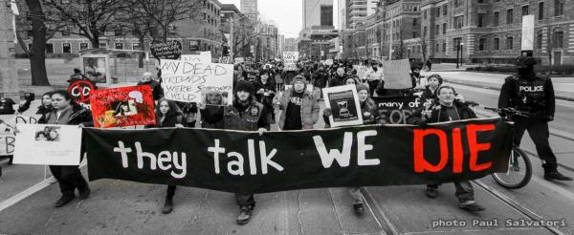
The Largest Public Health Crisis of a Generation
Notes:
- Even though everyone in this room knows exactly how bad the poisoned drug crisis is, and everyone here has a list of names they carry close to their heart, I always feel compelled to acknowledge this loss

Slide 3
Canadian deaths in 6 years: 27000 +
Year | Canada | Ontario
2016 | 3017 | 867
2017 | 4100 | 1265
2018 | 4588 | 1471
2019 | 3811 | 1512
2020 | 6214 | 2600
2021 – Jan-Sept | ? 7000 + | 2035
> 90% due to fentanyl
Notes:
you can see here that fatal overdose rates have been increasing by double digits every year we have been measuring
We hear a lot about the Downtown Eastside being the epicenter of these overdose deaths, and we hear about the solutions coming out of Vancouver.
But in Ontario where I work, we had the dubious distinction of surpassing BC death rates in 2019 and this has only gotten worse…. since 2020, northern Ontario communities such as Timmins and Thunder Bay have surpassed the Downtown Eastside in the per capita death rate due to overdose
Smaller cities like London, and our rural, remote and northern communities that predominate provinces like the Maritimes are where this crisis is killing people now, and this means that the solutions to save these lives will often look very different than what works in the highly concentrated geography that is the DTES in Vancouver
I would like to call your attention to the fact that beginning in March 2020, in the first wave of the pandemic, we saw a 60% increase in fatal overdose rates in Ontario
Our numbers from 2021 are on track for us to see ANOTHER 60% increase in fatal overdoses OVER AND ABOVE the 60% increase in deaths from 2020

Slide 4

2022
Harm
Marginalization
Status Quo
Fentanyl
2016
Notes:
The Safer Supply program in London is the first take home Safer Supply program in Canada
The work in London started in 2016 out of a desperate attempt to keep people alive
At that time, I was at my wit’s end as a doctor
Fentanyl had been on the streets of London for 2 years, people were dying, and none of the traditional addiction medicine interventions available to me were helping people
I felt powerless to help the people I cared for
From what I know of your drug supply here in Halifax and the rest of the Maritimes, you are still sitting on the precipice we were on in 2015/2016 in Ontario
My understanding is that you are still about a 90% pill, 10% fentanyl market, and that the pills of choice here are dilaudid and hydromorph contin
***************************************
By serendipity around this time, I was also observing the results of one of our local in-hospital doctors
This doctor managed the opioid withdrawal of people who use drugs with high doses of intravenous opioids while they were in-hospital being treated for medical conditions. These opioids allowed people to stay and complete their medical treatment in hospital
this doctor would then discharge people from hospital with prescriptions for oral hydromorphone tablets, which they would then inject
patients would do really well after they came out of hospital with these prescriptions
People would avoid overdose, avoid hospital admissions, they would attend clinic
But when the prescription from that hospital doctor ran out, people would turn to the street supply of fentanyl again, and we would re-start the cycle of withdrawal and illness
So, in 2016….I took a leap and started to continue prescribing hydromorphone tablets for these patients to inject after their hospital script ran out
And the positive benefits we initially observed continued
We added 5 patients here, 10 patients there… and before we knew it we had a program
We now have approximately 300 people on Safer Supply here at the Health Centre

Slide 5
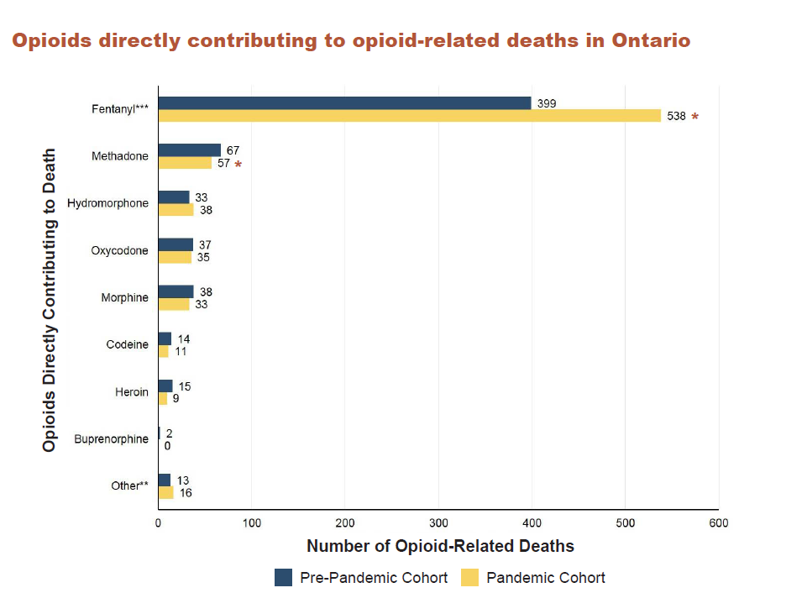

8%
79%
%
87%
2021
> 90% due to fentanyl
Notes:
Those of us watching from Ontario are both jealous that you haven’t made the flip to our reality of a greater than 90% fentanyl market, and also nervous… we want to use our experience to prevent that flip in any way we can. I’d really like to address this in our discussion at the end of this panel, and informally with anyone who would be willing to listen to me ramble at lunch
This is a report released by the Ontario Drug Policy Research Network, showing 79% of pre-pandemic fatal opioid overdoses were caused by fentanyl, and that this rose to 87% during the pandemic
Currently, more than 90% of opioid overdose deaths are caused by street fentanyl

Slide 6
Emerging issues
Increased community tolerance
Prior to 2020, fentanyl use measured in points (0.1g)
2016-2019, average daily fentanyl use in London was 1-5 points
Post March 2020, average daily use is measured in full grams, often ½ ball to full ball (1.7 – 3.5G, 17-35 points)
High users may use multiple balls per day, even up to an ounce
Notes:
we ALSO want to prevent what comes after fentanyl dominates a market… which is a nearly vertical climb in people’s tolerance
- in the first 4 years of the safer supply program in London, from 2016 until just before the pandemic began in 2020, the average daily use was 1-5 points of fentanyl
But since COVID, community use levels have skyrocketed, and now most of the patients I see are measuring their fentanyl in grams, ½ balls or balls

Slide 7
Methadone 2900mg
Hydromorphone 1760mg
1 point FYL = 0.1g = 100mg
Median purity 4.4%
1 point = 4.4mg = 4400mcg FYL
164 - 656 percocets
PER DAY
1 point = 440 MEQ
Avg daily use 5-20 points
Avg daily MEQ 2200 - 8800
Notes:
And Why does this matter?? I will show you some math
1 point of fentanyl can be converted to 440 morphine equivalents, or “MEQ”.
This means that if you took 1 point of fentanyl, it would be the same as you taking 440mg of morphine
If the average daily street use is 5-20 points, that is 2200 – 8800 mg of morphine per day per person of unregulated street based opioid
To put this in perspective, this is 2900 mg of methadone, or 1760mg of hydromorphone, or 164 – 656 percocets per day, PER PERSON
can we please all pause and have a collective (whisper) “WHAT THE FUCK” at these numbers
- we need to figure out how to prevent THIS in Atlantic Canada

Slide 8
Background: SOS program at LIHC
SOS program started in 2016 at LIHC; funded by SUAP in March 2020
Harm reduction approach to addressing substance use
Model: Primary care with interdisciplinary wrap-around services
  Access to care facilitators, outreach workers, system navigators, nurses, nurse practitioners, physician
  Access to comprehensive medical care as well as safer opioid supply for people meeting eligibility criteria
Notes:
From 2016 until now in 2022 the Safer Supply program has grown from 3 patients to over 300
And the program is about Safer Supply for sure, but it’s also about providing culturally appropriate care to people who use drugs, using a robust team based approach

Slide 9
SOS Evaluation goals
Examine impacts of SOS on clients
Explore client and staff perspectives on what is working well
Explore client & staff perspectives on what could be improved
Make recommendations for the program and the health system
Mixed methods
  Survey of clients starting SOS
  Survey of current SOS clients
  Focus groups with clients, staff & with people on the SOS waitlist
Notes:
The evaluation was a mixed methods approach, using surveys of patients both on Safer Supply and on the Safer supply wait list, as well as surveys with staff and focus groups with both patients and staff
** Address what this evaluation is not meant to do

Slide 10
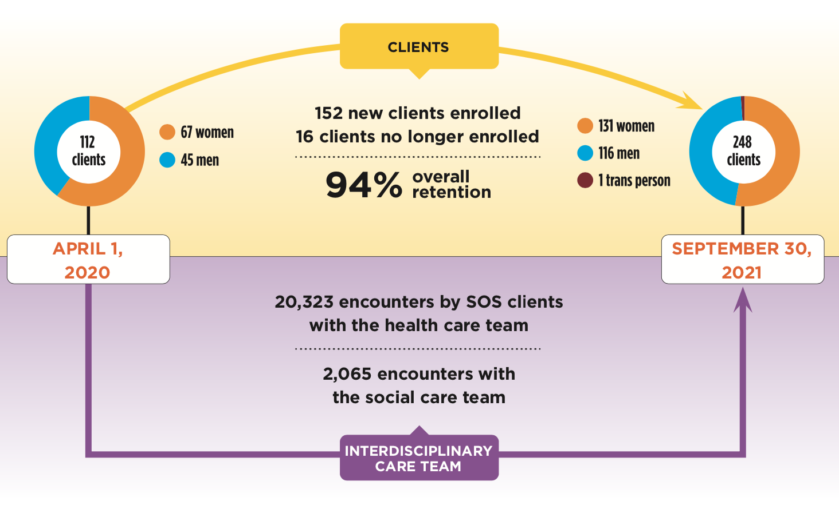
SOS program statistics
Notes:
First off, Safer Supply in London has an excellent retention rate, at 94%,
This can be compared to a 40-50% retention rate for methadone at 6 months

Slide 11
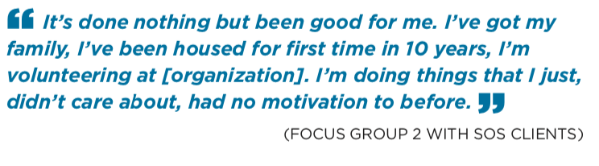
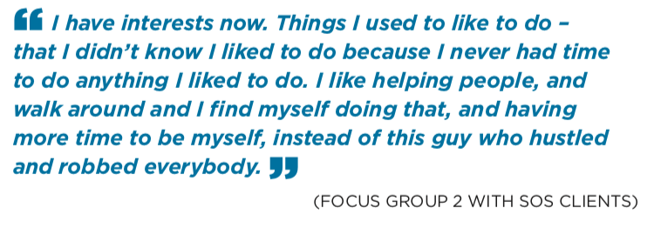
SOS program impacts
Notes:
Our evaluation showed overwhelmingly positive impacts on program participants
- This person says ….

Slide 12
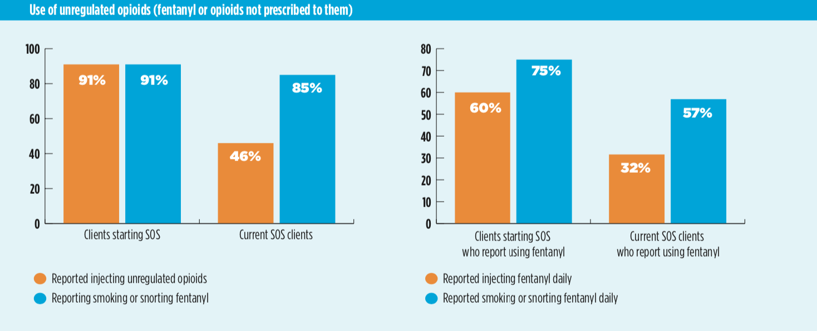
Use of unregulated opioids
Notes:
- 63% of our patients report that their fentanyl use has decreased since starting Safer Supply

Slide 13
Notes:
This was a finding that surprised even us
I want you to remember that every patient started on Safer Supply had the intention of continuing to inject drugs, albeit in a safer way
AND YET…. We see 35% of our patients stop injecting altogether

Slide 14
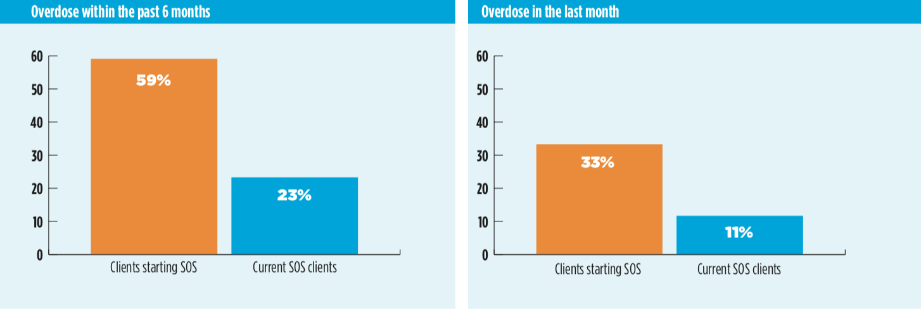
Overdose
Notes:
We have seen a dramatic reduction in overdoses
You can see we have dropped overdoses in the last 6 months from 59 to 23%
And overdoses in the last month from 33 to 11%

Slide 15
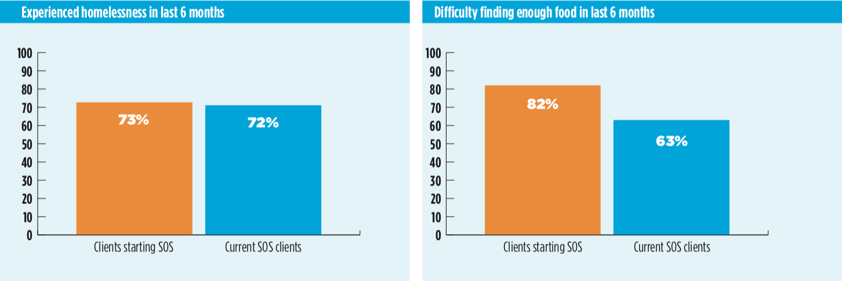
Homelessness and food insecurity
Notes:
- We saw really great numbers of folks moving into housing in the program pre-2020. However the rental housing market in Ontario has collapsed and increased exponentially in price since 2020, and we struggle to move the needle on this aspect of our patients health, which intrinsically means we can’t improve people’s physical and mental health as much as we did when we had access to housing stock

Slide 16
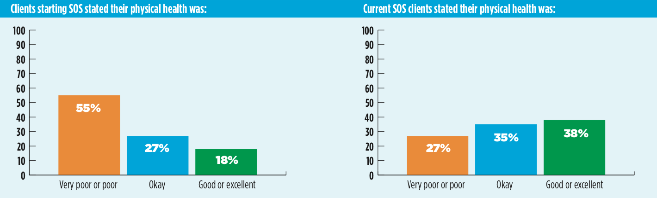
Physical Health
Notes:
- Even so, 59% of our patients say their physical health has improved since beginning Safer Supply

Slide 17
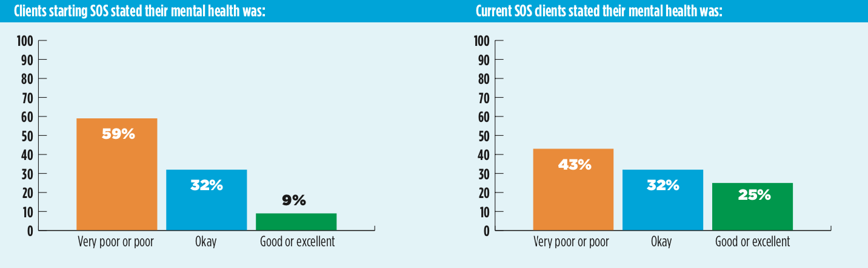
Mental Health
Notes:
- And 53% of folks also said their mental health has improved since starting the program

Slide 18
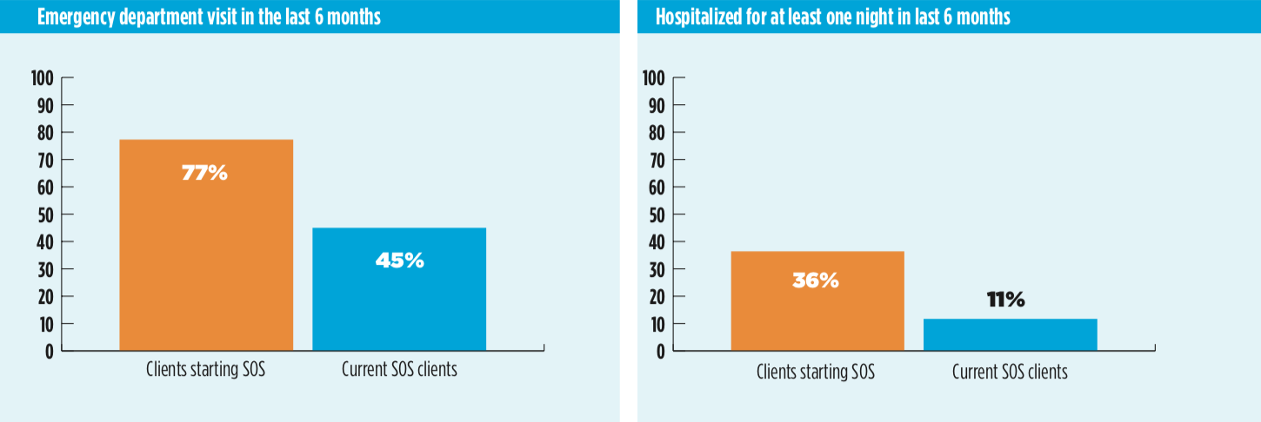
Health Services Use
Notes:
We have reduced emergency department use from 77 to 45%, and decreased hospital admissions from 36 to 11%.

Slide 19
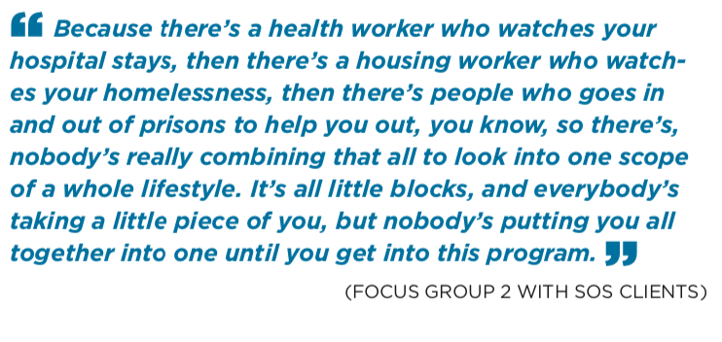
Impact of wrap-around care
Notes:
We also see the impacts of wrap around, team based primary care, which is made possible by the SUAP funding supporting our program
This person compares the fragmented care they used to experience, with how they currently experience care at the Health Centre

Slide 20
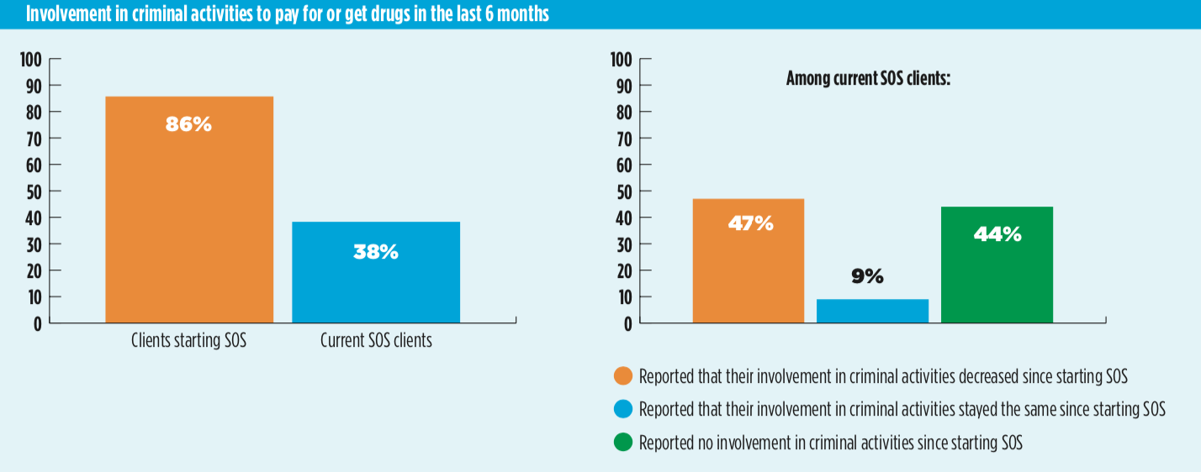
Involvement in criminal activities
Notes:
Beyond health outcomes, we have also seen a decrease in engagement in criminalized survival activities like petty crime
Here you can see that 86% of our patients engaged in crime before being on safer Supply, almost always to pay for their drugs, but fully 44% of folks have stopped ALL criminal activities once they have a prescription, and another 47% say they have reduced

Slide 21
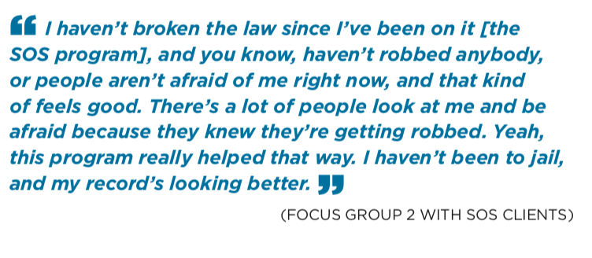
Decreased involvement in criminal activities
Notes:
This person says:

Slide 22
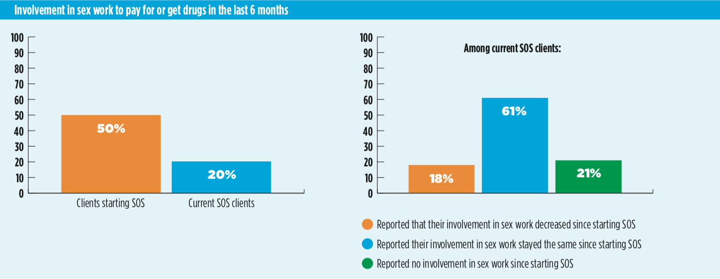
Involvement in survival sex work
Notes:
- We have also seen reductions in the number of women performing sex work, because women no longer need to work to make hundreds of dollars per day to pay for unregulated street drugs

Slide 23
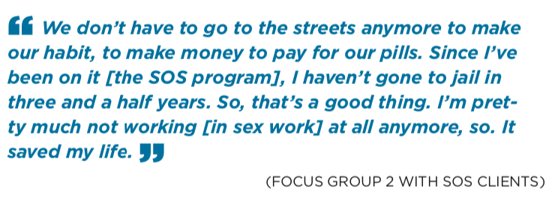
Decreased involvement in sex work
Notes:
- This woman says:

Slide 24
“What if, instead of talking about hard to reach patients, we flip that around and talk about hard to reach doctors?
Or hard to reach services?
Or services with dumb barriers or restrictions on access?
Or a system with shitty attitudes?”
Notes:
This is my last slide
Before we finish, I will leave you with a quote from a dear friend of mine who uses drugs
Read quote
To me, this means that we need to centre our patients when we are designing programs and new treatments; we need to stop centring our own agencies, or our own comfort, or the morals of medicine or the conventional morality in society about drug use
To save lives in the fentanyl era we need to get uncomfortable, and brave, and creative

Slide 25
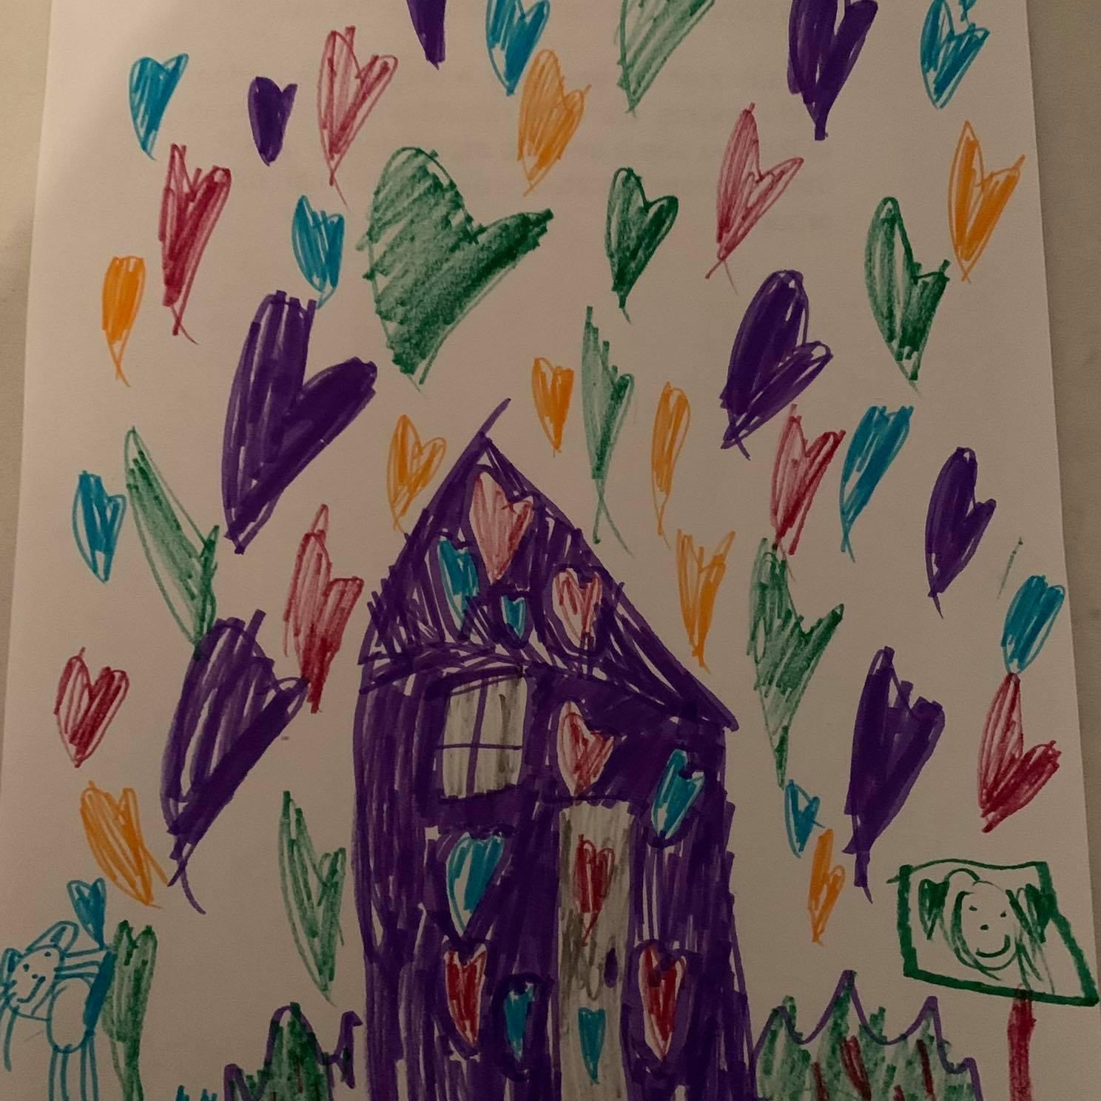
WHAT DO WE NEED
Notes:
My 7 year old daughter drew this picture, and it fills my heart every time I look at it
She is able to encompass, with a child’s heart, what housing should mean
Minister, I recognize that you are not in charge of solving the housing crisis in Canada
But for our patients, housing is healthcare
Without stable, affordable, supportive housing, many of your investments in Safer Supply programs will not be able to realize their full potential
I would argue that most of your investments in mental health and addictions will fall flat if the housing crisis is not concurrently addressed
And so we would ask that housing be considered a priority in solving the overdose crisis as well

Slide 26
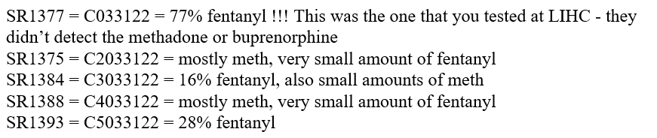
Notes:
These are five samples taken from a batch of fentanyl that was moving through London 3 weeks ago
This was a particularly bad batch of drugs that was dropping people at a very high rate
When we tested one sample it was 77% fentanyl….. For reference, the provincial average is 4%
The next 4 results you see… ranging from 0 to 17 to 28% fentanyl… those are all from the same small batch (show with your hands)
THIS is the chocolate chip cookie effect in action, and it killed Londoners for 2 weeks
you see batches like this because the street supply of opioids is unregulated
We saw the same type of deaths during alcohol prohibition in the 1920s… this was a time when people might end up drinking moonshine that was 11% or 80%. Sometimes you got pleasantly buzzed, sometimes you went blind. Who knows which it would be?? (be silly)
The LCBO fixed this problem… you can now walk into a store and buy alcohol at a known concentration. This doesn’t mean you won’t drink too much, or fall down and hit your head, or develop liver disease from 30 years of drinking
But because the government regulates the concentration and quality of your alcohol, you won’t die from acute alcohol poisoning
the same thing is now true of cannabis
Before your Liberal government regulated cannabis products, someone might get a mild ditch weed that was 5% THC… or they might end up with a potent strain that was 25%. No one knew
Now you can walk into shiny cannabis stores across the country, you can talk with cannabis experts about different strains, and you can pick a cannabis product that is within your tolerance, and safely consume it
The Liberal government, by legalizing and regulating cannabis, made cannabis much safer for Canadians
So I ask this group…. Why do we regulate drugs like alcohol and cannabis, and make them safe for the people who consume them….. But we are unwilling to do the same for opioid users?
Spoiler alert (smile): the answer is stigma, racism and classism
(be coy) - And if you want to debate this fact with me over a safe beer in a supervised alcohol consumption site, oh I mean bar… tap me at the end of this presentation, I’m game (wink)

Slide 27
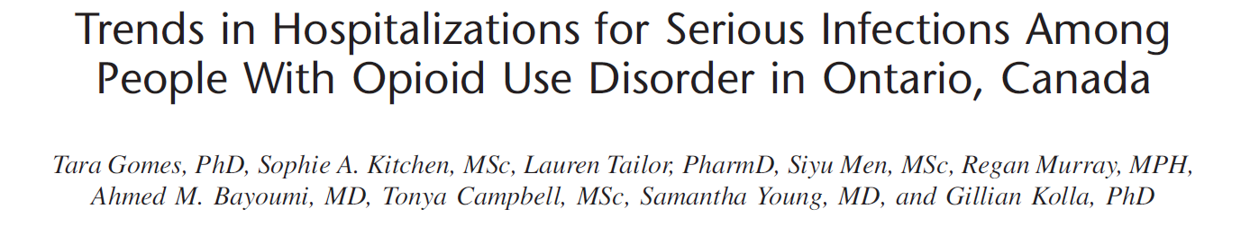
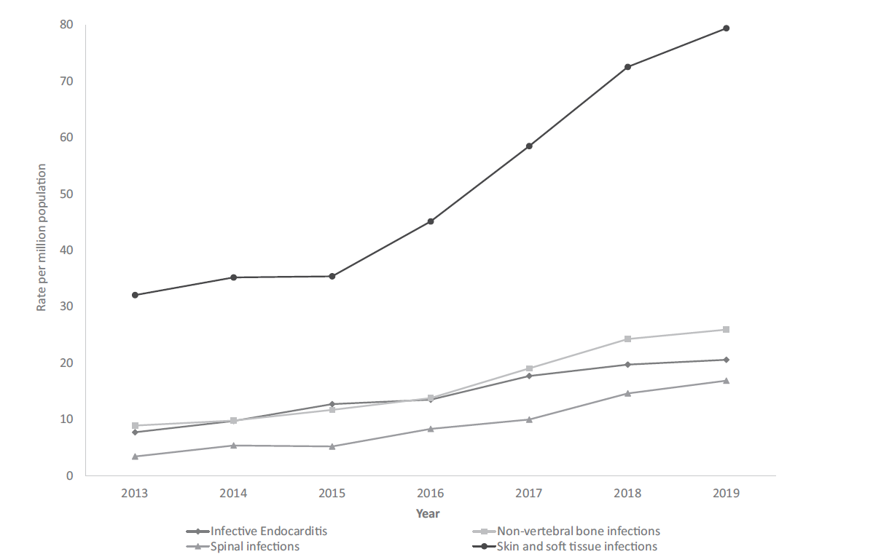
Skin and Soft Tissue 147%
Non-vertebral bone 191%
Infective endocarditis 167%
Spinal Infections 394%
Notes:
Beyond overdose, Fentanyl is also driving an increase in infections of all types among people who use drugs
this study showed that over 7 years, the rate of serious infections grew significantly, with a sharp increase in 2015 when fentanyl hit the scene
You can see there was a 167% increase in the rate of Infective endocarditis, which is a heart infection
a 394% increase in spinal infections
a 191% increase in bone infections
a 147% increase in skin or soft tissue infections
And these infections, particularly endocarditis, cost our hospital system 100s of thousands of dollars per patient, and they fill a hospital bed for 6-8 weeks while the person receives heavy duty antibiotics which they can ONLY receive in-hospital

Slide 28
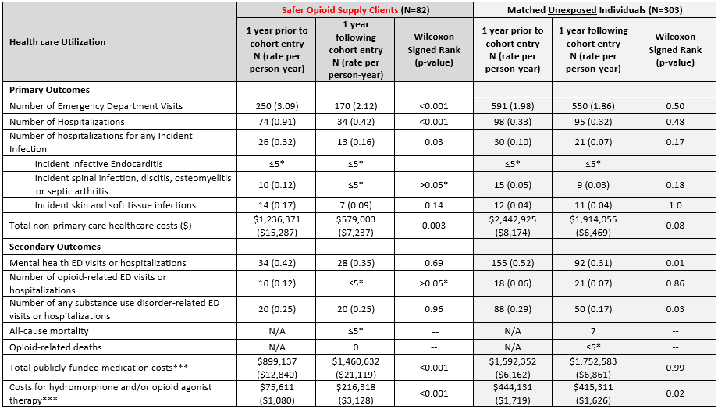
31% reduction
emerg visits
54% reduction
hospitalizations
53% reduction
Non-primary care costs
No improvements in these outcomes among matched controls also living in London but not part of the safer supply program
Notes:
I would now like to show you how much money Safer Supply is saving the hospital system
This is a study conducted by Dr. Tara Gomes and other members of our team
This paper is being submitted for publication very soon, so I ask that this data please be kept within the parties at this table
We would be happy to discuss more details of this data with your team before publication if this group is interested
For this study, we compared Safer Supply patients between Jan 2016, when the program first started, and March 31, 2019
We compared the 82 patients who were on the program at that time, to other people in London who were also injection fentanyl users and who had the same medical complexity as our Safer supply patients
I want you to note that this time period was BEFORE we received our funding from SUAP… so the data in this paper represents health gains and cost savings that are attributable to ONLY prescribing… at this point the “program” was only me and my prescription pad and a tiny staff complement, all of us doing this off the side of our desks
With very minimal resources, you can see we reduced emerg visits by 31% compared to our controls, and we reduced hospital admissions 54%.... primarily by reducing the rate of those serious infections I talked about at the beginning of this presentation
We also showed a 53% reduction in non-primary care related health costs
We reduced costs from 1.23 million dollars to 579K for this group of 82 injection drug users…. Simply. By. Prescribing. Safer. Supply
The ONLY intervention these 82 people received was a prescription for opioids!!!!
This begs the question….. Are people who inject drugs the problem? Is it even injection drug use that is the main problem?
Or is it the system we have in place that makes their drug use illegal and underground and unsafe the problem? Because again…. These 82 people got better simply by having a clean, regulated supply…. From my prescription pad
We received SUAP funding for Safer Supply in Feb 2020
It was at this point we were able to add robust wrap-around primary care for all Safer Supply patients
Our next step will be to study this cohort that has been cared for under SUAP funding… I have every expectation that health outcomes and costs savings will be even more wildly significant with the support of wrap-around care funded by SUAP and Health Canada.

