Slide 1
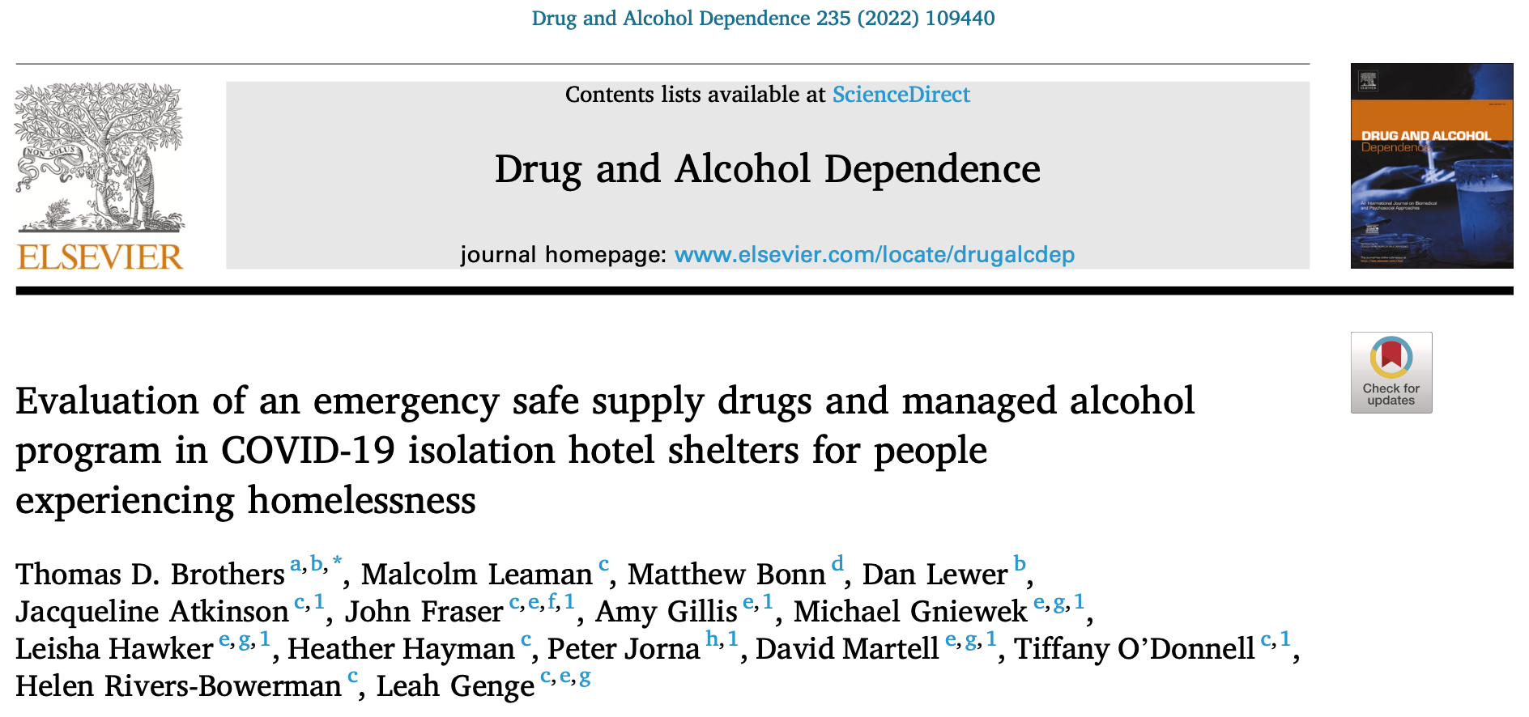
thomas.brothers@dal.ca

Slide 2
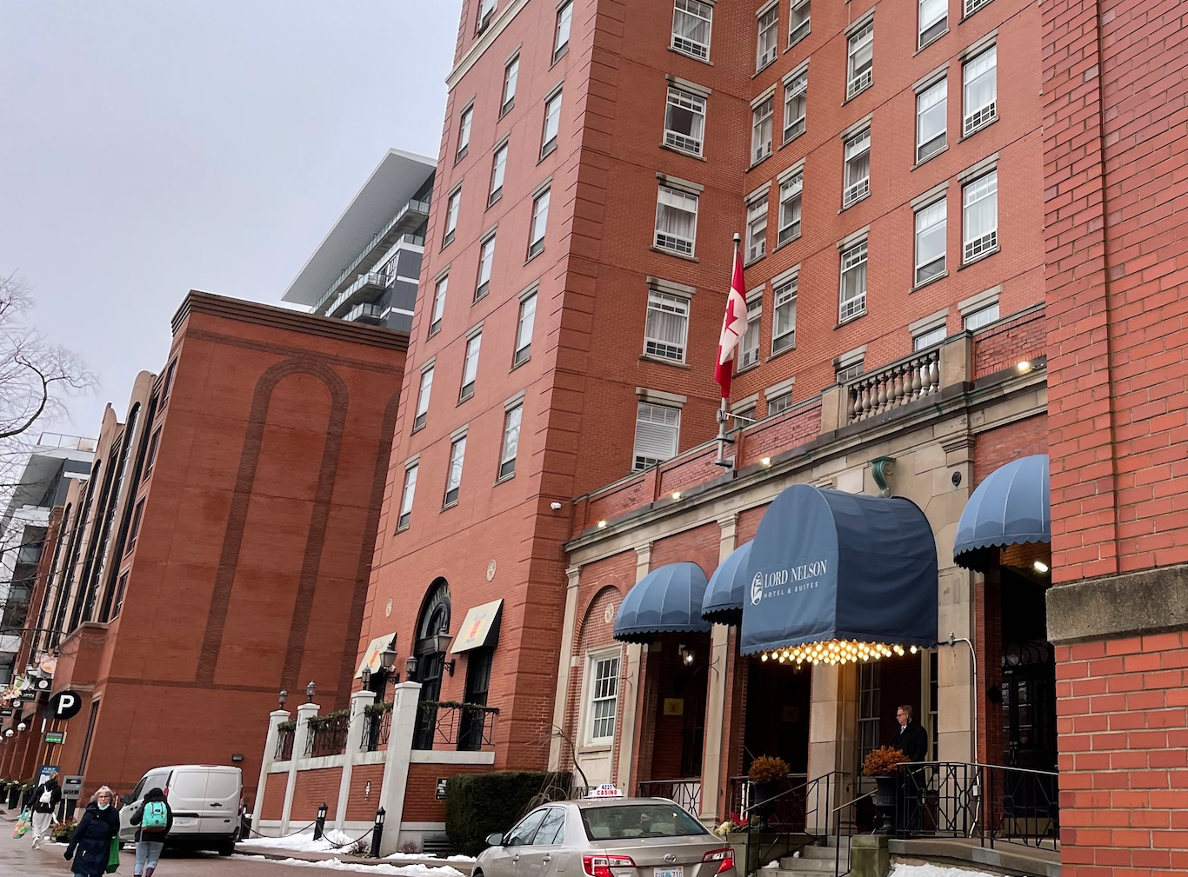

Slide 3
Summary of prescribing guidance
Opioids
Offer OAT (methadone, buprenorphine, or SROM) to all patients with opioid use disorder
Oral hydromorphone IR 8mg tablets, 1-3 tabs q3h as needed
Max. daily dose of 112mg hydromorphone (14 tablets)
Stimulants
Methylphenidate SR 20-40mg tablets once daily and/or methylphenidate IR 10-20mg tablets twice daily
Max. daily dose of 100mg methylphenidate
Dextroamphetamine SR 10-20mg tablets once daily and/or dextroamphetamine IR 10-20mg tablets twice or thrice daily
Max. daily dose of 80-120mg dextroamphetamine
Alcohol (strong beer); tobacco/nicotine; benzodiazepines

Slide 4
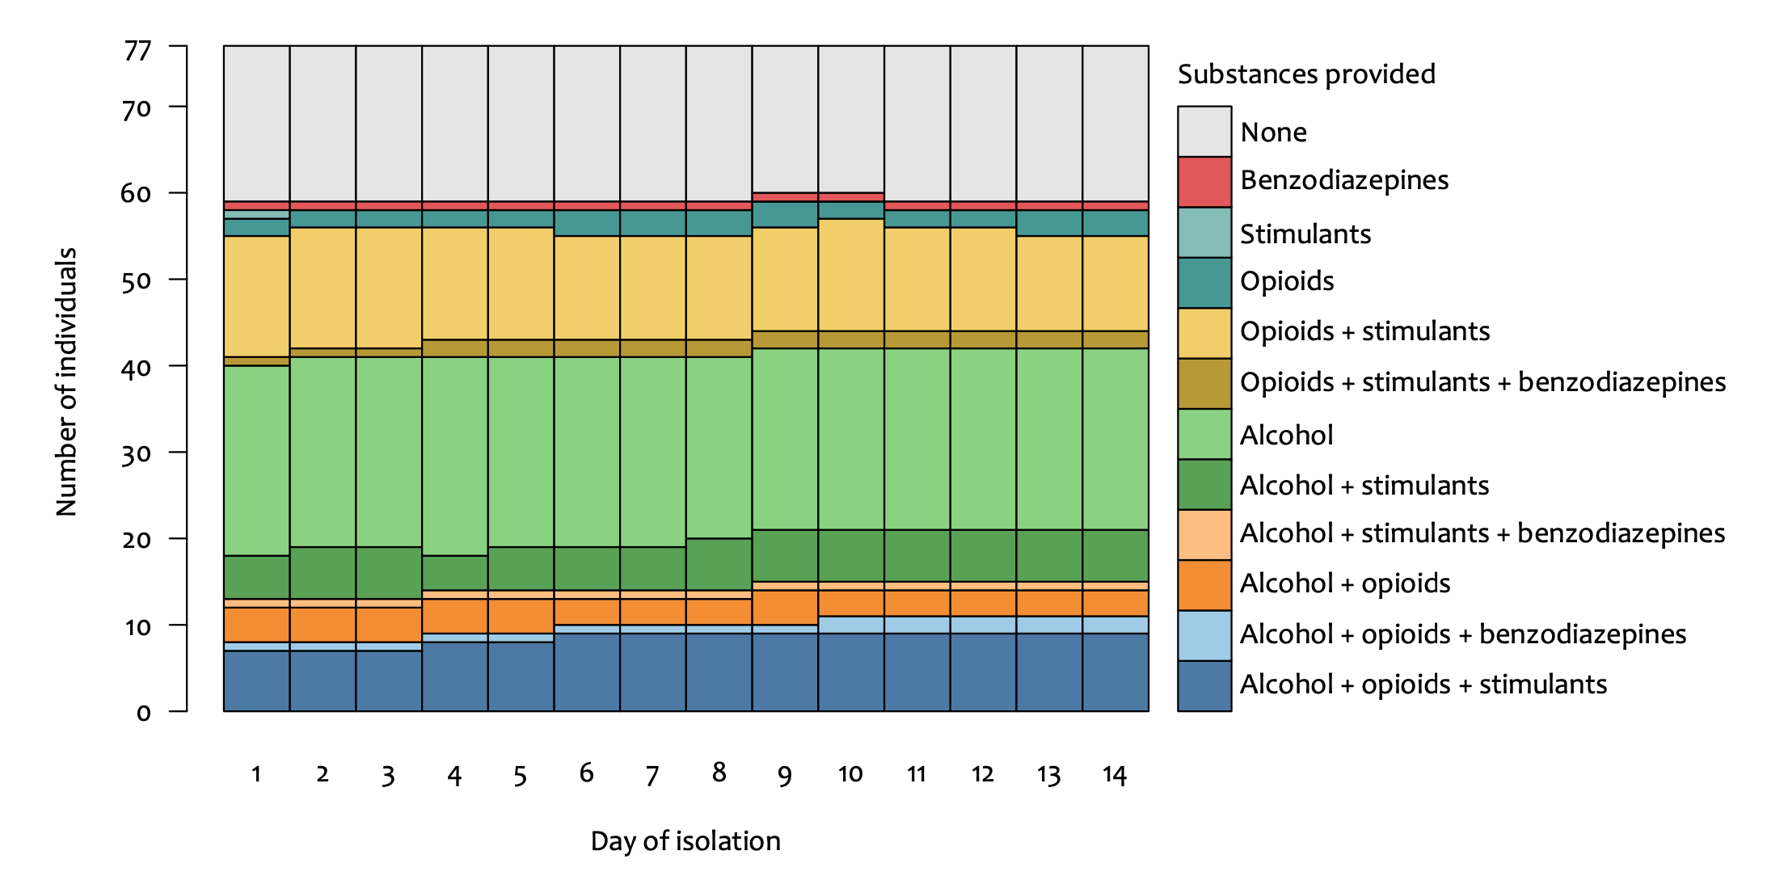
Results: Substances
Notes:
77 residents were assessed, and 62 (81%) residents were provided medications, alcohol, or cigarettes.
17 (22%) residents received opioid agonist treatment (methadone, buprenorphine, or slow-release oral morphine).
27 (35%) received hydromorphone.
31 (40%) residents received prescriptions stimulants.

Slide 5
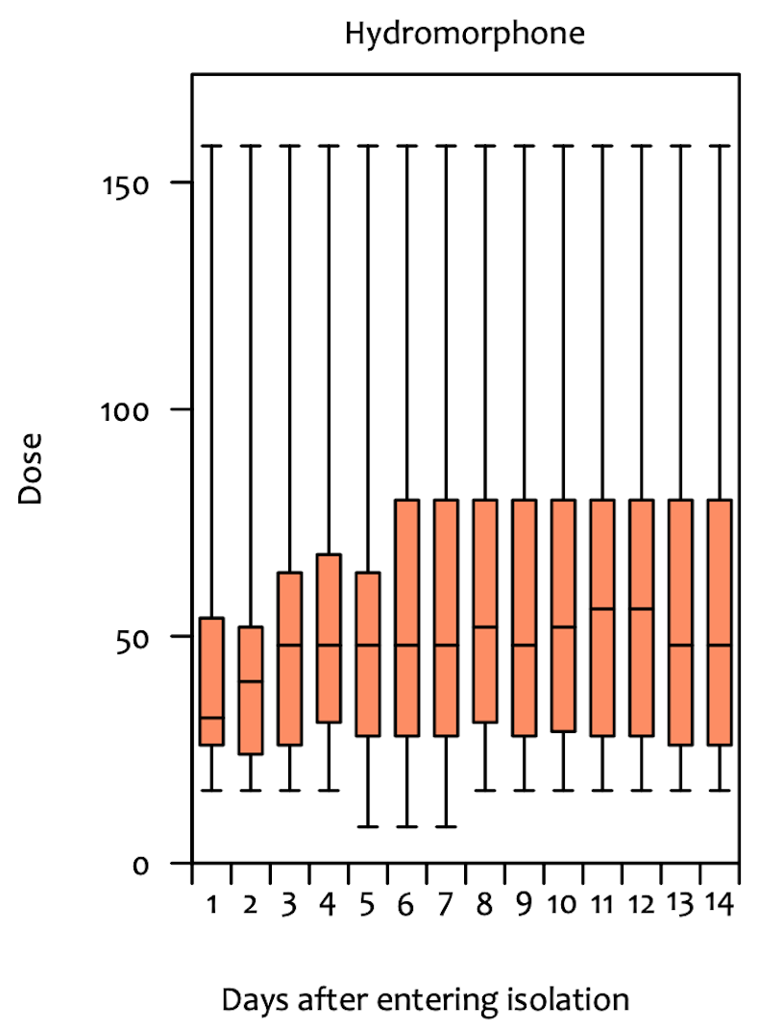
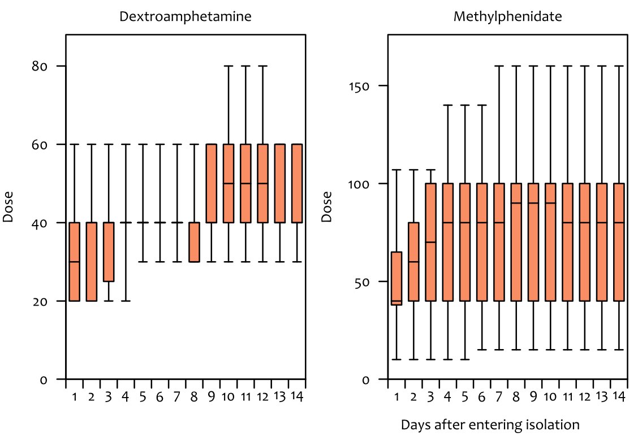
Results: Dosages
Notes:
Hydromorphone = 27 (35%) residents
Methadone = 7 (9%) residents; buprenorphine = 1 (1%); SROM = 10 (13%)
71% of residents receiving OAT also received hydromorphone;
Over 14 days in isolation, mean daily dosages increased of hydromorphone (45±32 [337 OME] to 57±42 mg [427 OME]), methylphenidate (51±28 to 77±37 mg)
Hydromorphone (n=27)
average dosages increased over residents’ time in isolation from day one (mean 45 mg ± 32 mg; median 32 mg; range 16–158 mg daily) to day 14 (mean 57 mg ± 42 mg; median 48 mg; range 16–158 mg daily) (Fig. 2).
Three (12%) of these 27 residents were prescribed hydromorphone dosages above the BCCSU guideline suggested upper limit of 112 mg daily (14×8 mg tablets).
The maximum daily dosage for methadone was 195 mg, for buprenorphine was 12 mg, for SROM was 800 mg; and for hydromorphone was 158 mg.
Methylphenidate daily dosages increased from day one (mean 51 mg ± 28 mg; median 40 mg; range 10–107 mg) to day 14 (mean 77 mg ± 37 mg; median 80 mg; range 15–160 mg).
Dextroamphetamine daily dosages increased from day one (mean 33mg±16mg; median 30mg; range 20 – 60mg) to day 14 (mean 46mg±13mg; median 40mg; range 30 – 60mg).
Four (15%) of 27 residents receiving methylphenidate were prescribed doses above the BCCSU guideline suggested upper limit of 100 mg daily.
Of eight resi- dents receiving dextroamphetamine, one (13%) required dosages above the guideline suggested upper limit of 120 mg daily.

Slide 6
Results: Outcomes
During 1,059 person-days in isolation, there were zero overdoses.
Six residents (8%) left isolation prematurely, but four returned.
Documented concerns regarding intoxication occurred six times (0.005 events/person-day) and medication diversion/sharing three times (0.003 events/person-day)

Slide 7
Prescriber reflections & subsequent developments

