Slide 1
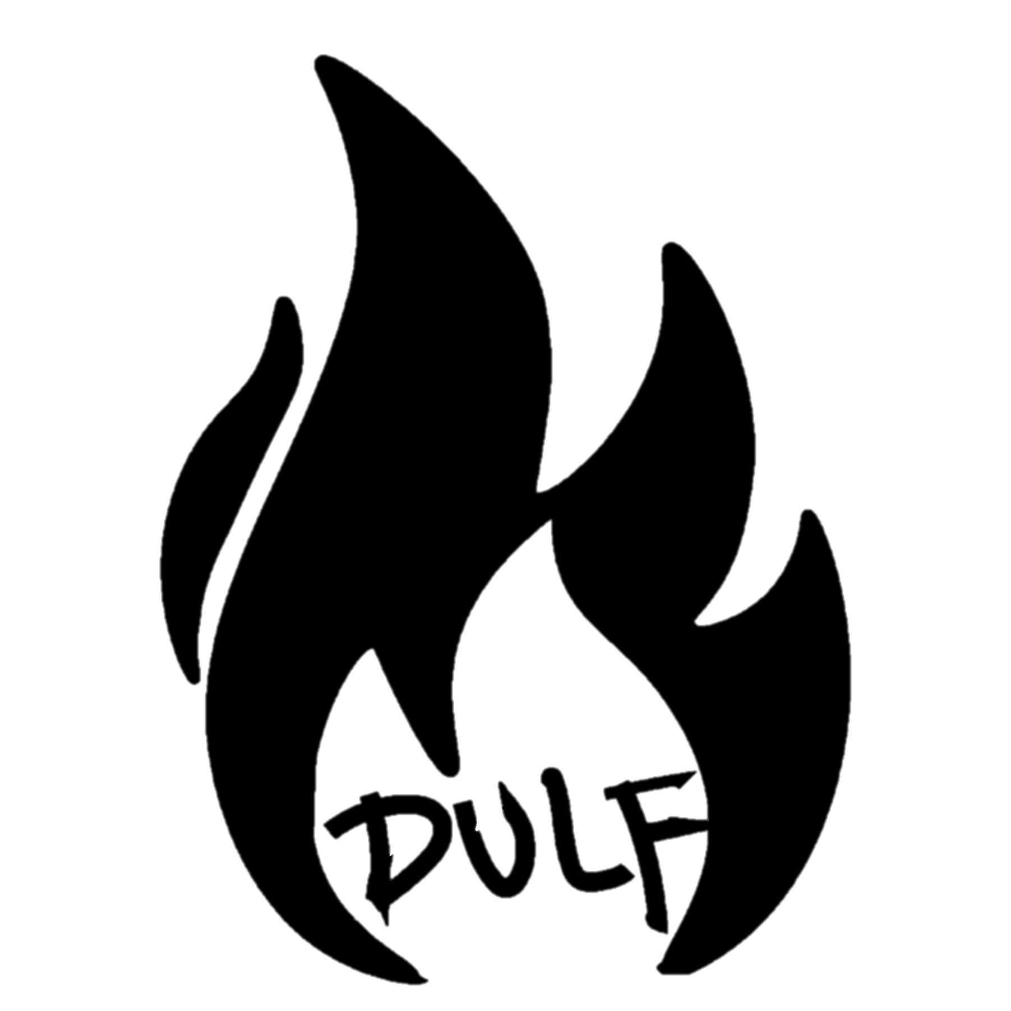
Community-led Compassion Clubs
The Logical Next Step in Harm Reduction

Slide 2
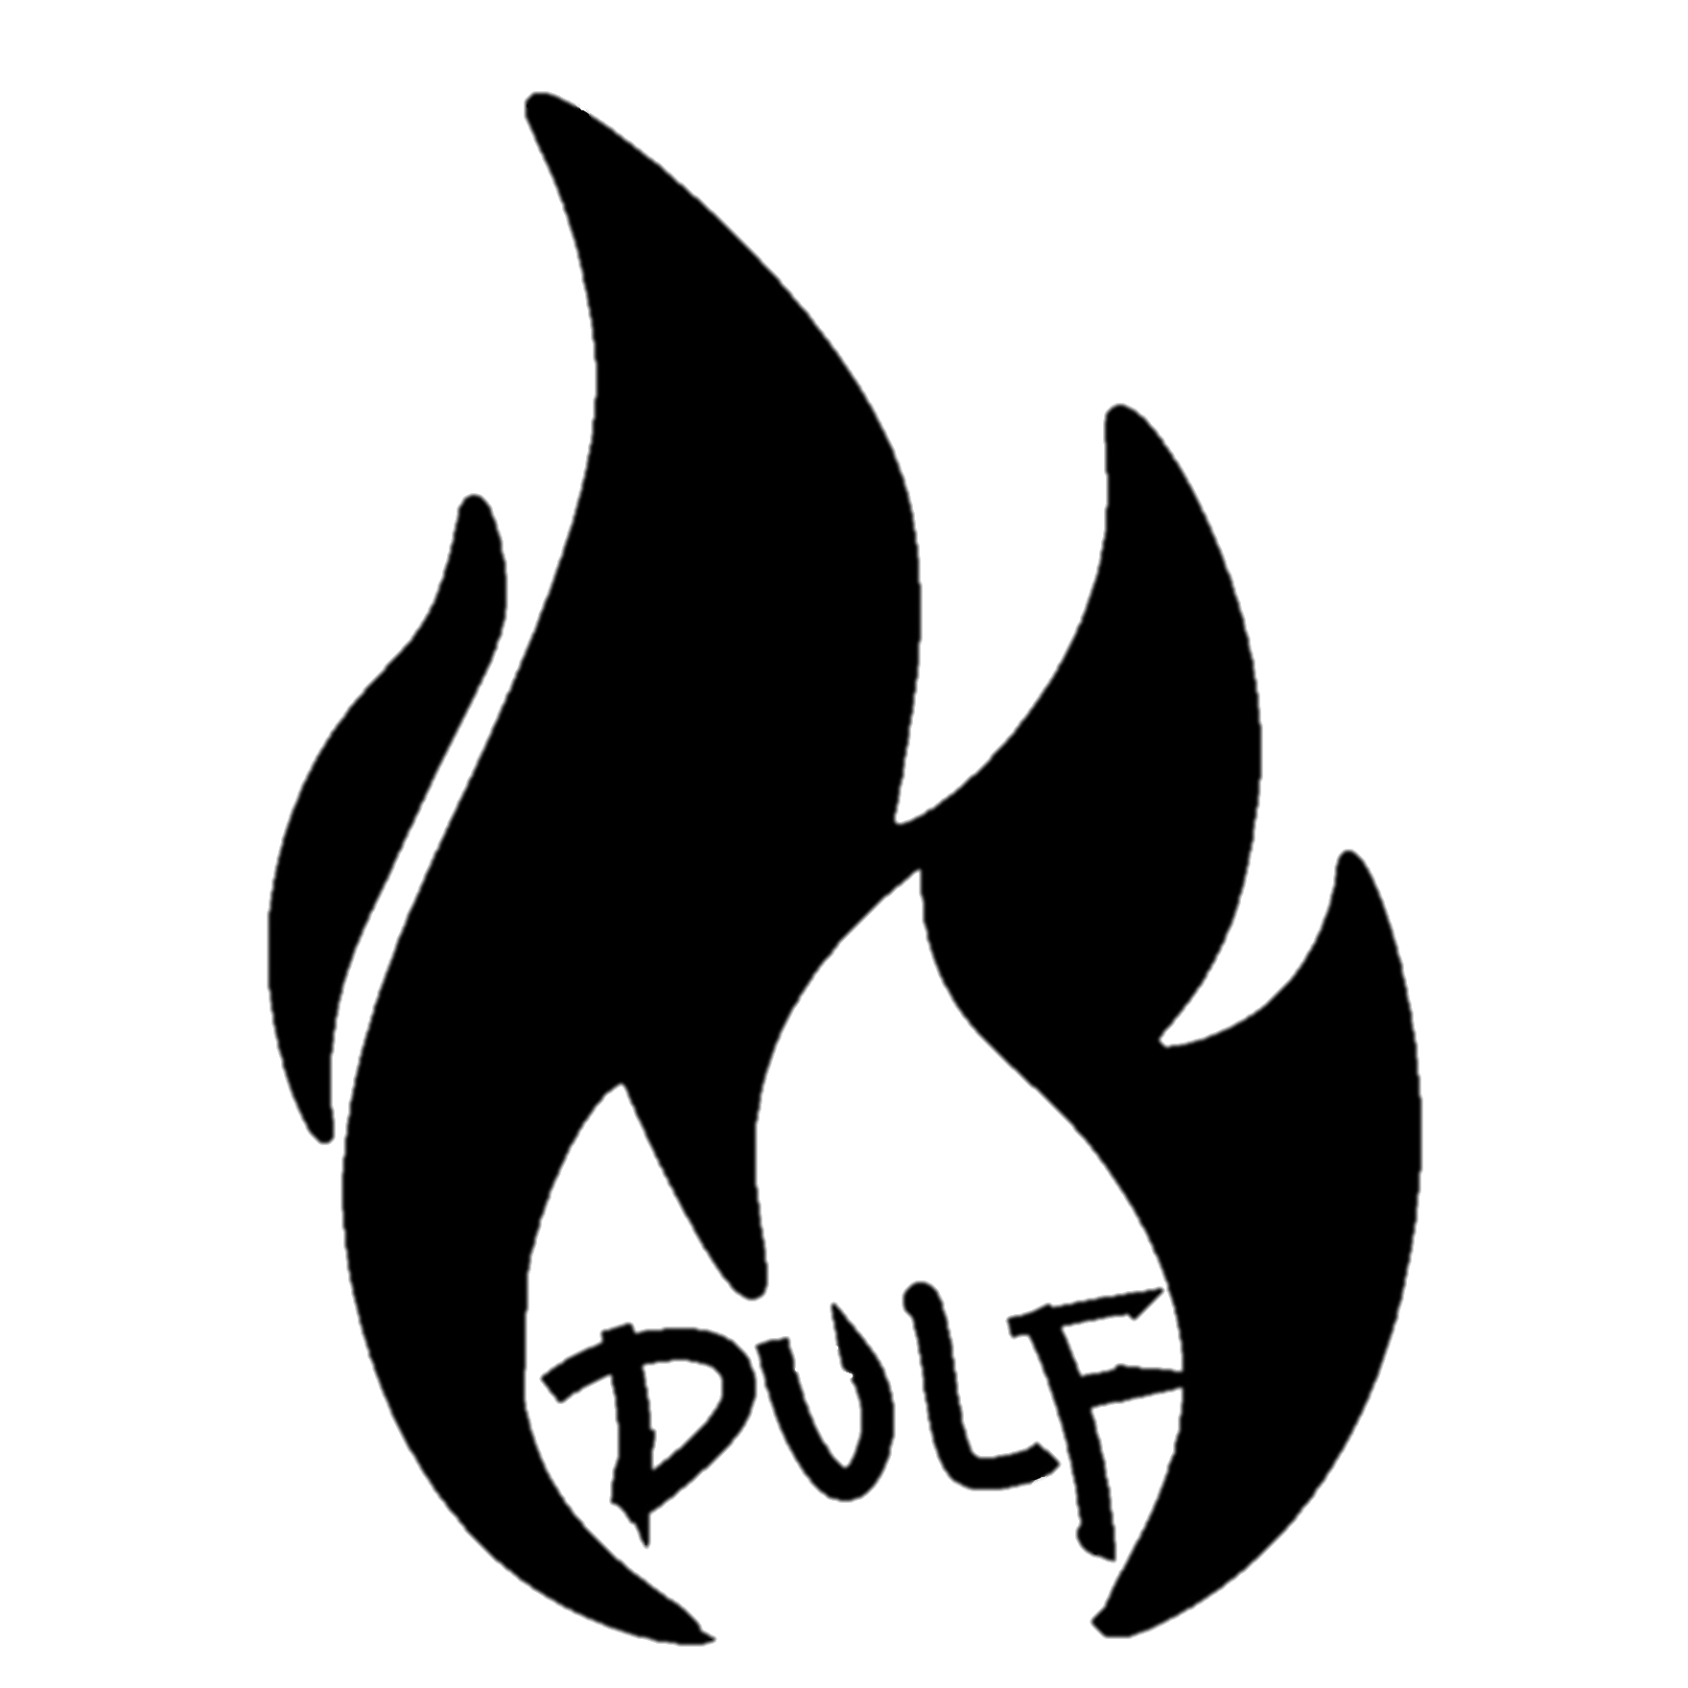

Who is the Drug User Liberation Front?

Slide 3
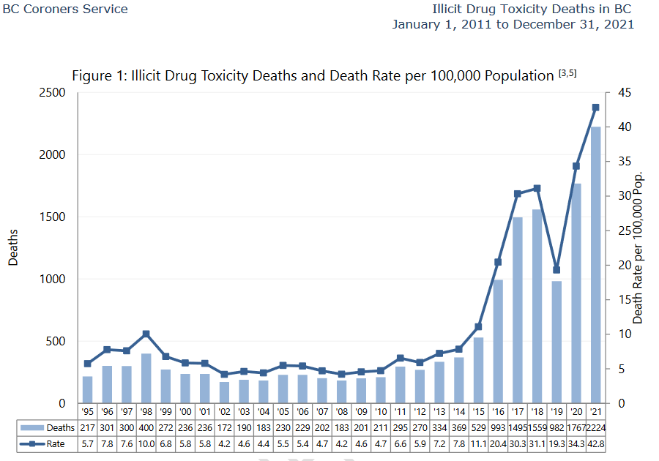


Slide 4

Our Position on Safe Supply
Safe supply – Substance of known potency and content, provided in a way to people who use drugs in a way that is accessible and accurately conveys the risks of the substance.
DULF’s argument:
  The Volatility of the Illegal Drug Supply is Killing People
  Providing Drug Users with Non-Toxic Drugs Vastly Lowers the Death Rate
  Barriers to Accessing Safe Drugs Cause People to Turn Back to Risky Street Drugs
  Prohibition Doesn’t Work
  The DULF Fulfillment Center and Compassion Club Model is Saving Lives Right Now and Will Save More if We are Permitted to Continue our Work

Slide 5
Driving Factors of Harms and Overdose
Overarching policies of Prohibition
  Encourages more potent and addictive substances such as Fentanyl, Carfentanil, Etizolam, Flualprazolam.⁵
  Requires that people hide their use lessening their ability to access harm reduction supplies and addiction services.
Enforcement
  Allows more violent and organized criminal forces to dominate the illicit market.⁶
Variability in Drug Potency and Content
  People do not know what they are taking or how potent it is.
  Unpublished BCCSU data has linked fentanyl variance and concentration to increased overdose deaths in Vancouver (Figures in next slide).
L. Beletsky, C.S. Davis, Today’s fentanyl crisis: Prohibition’s Iron Law, revisited, International Journal of Drug Policy (2017), http://dx.doi.org/10.1016/j.drugpo.2017.05.050
Werb, D., Rowell, G., Guyatt, G., Kerr, T., Montaner, J., & Wood, E. (2011). Effect of drug law enforcement on drug market violence: A systematic review. International Journal of Drug Policy, 22(2), 87–94. https://doi.org/10.1016/j.drugpo.2011.02.002

Slide 6
Driving Factors of Harms and Overdose
Doctors and the medical system are part of the problem.
The medicalization of safe supply is ineffective.
Measures taken to provide safe supply in a medicalized context have been deeply flawed.
  Prescribers do not want to prescribe and do not want to be the gatekeepers to safe supply.¹ This has been due to bullying by colleagues and fear of their college.²
  Receiving a substance use disorder is harmful to people who have managed or recreational use patterns.³
  Medicalization reduces harm reduction uptake and effectiveness.⁴
Tyndall, M. (2020). A safer drug supply: A pragmatic and ethical response to the overdose crisis. CMAJ, 192(34), E986–E987. https://doi.org/10.1503/cmaj.201618
Myhill-Jones, B. J. (2021). RE: A safer drug supply: a pragmatic and ethical response to the overdose crisis. https://www.cmaj.ca/content/re-safer-drug-supply-pragmatic-and-ethical-response-overdose-crisis-0
“Discrimination Against Patients With Substance Use Disorders Remains Prevalent And Harmful: The Case For 42 CFR Part 2, " Health Affairs Blog, April 13, 2017.DOI: 10.1377/hblog20170413.059618
Kolla, G., & Strike, C. (2021). Medicalization under prohibition: The tactics and limits of medicalization in the spaces where people use illicit drugs. Drugs: Education, Prevention and Policy, 28(2), 127–137. https://doi.org/10.1080/09687637.2020.1769029

Slide 7
Prohibition Doesn’t Work
Prohibition causes a three fold increase in:
  The potency of drugs.
    More potent drugs are easier to smuggle.
  The toxicity of drugs.
    Deregulation in the market causes the supply chain to be unpredictable.
  The power of organized crime.
    Supply will always meet demand.
Alcohol is the most dangerous drug, both to society and the individual, yet it is legal to protect consumers.
DULF is a consumer protection initiative (i.e. the FDA for narcotics).

Slide 8


A Non Carceral and Non Medical Intervention

Slide 9
DULF Compassion Clubs as a Solution
A unique approach to compassion clubs
  Integrate into existing lines of substance distribution and increase power of consumers.
  Purchase substances from community and online sources, test the substances, package and accurately label.
  Redistribute to compassion club members in a safe and accountable environment.

Slide 10
Why We Cannot Wait
Overdose deaths continue to increase at an alarming rate.
Politicians and the general public have proven to be apathetic to the ongoing crisis. If we do not step in to stop the death, no one else will.
We are watching new crises develop as a result of an unregulated drug market. (Benzodiazepine contamination, severe and frequent infections, introduction of Carfentanil).

Slide 11
DULF is Uniquely Situated to Intervene
Deep and meaningful connections with the provincial network of PWUD and local drug user organizations.
Technological skills to be able to source substances from the dark web which increases safety and market accountability.
We are willing and able to work with all stakeholders to keep people who use drugs alive and healthy, and keep our communities safe.
We have demonstrated that we have no desire to profit off this intervention.

Slide 12
How It Works
Membership
Assessment
Market Navigation
Quality Control
Packaging and Labeling
Distribution

Slide 13
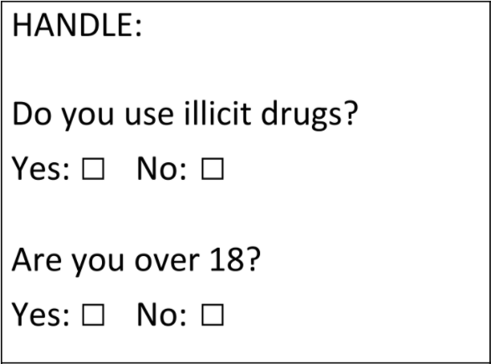
Membership Assessment
Assessment is conducted in-person by club peer.
If they are accepted, they fill out membership form.
Membership in an existing and established drug user group is also accepted in lieu of membership.

Slide 14
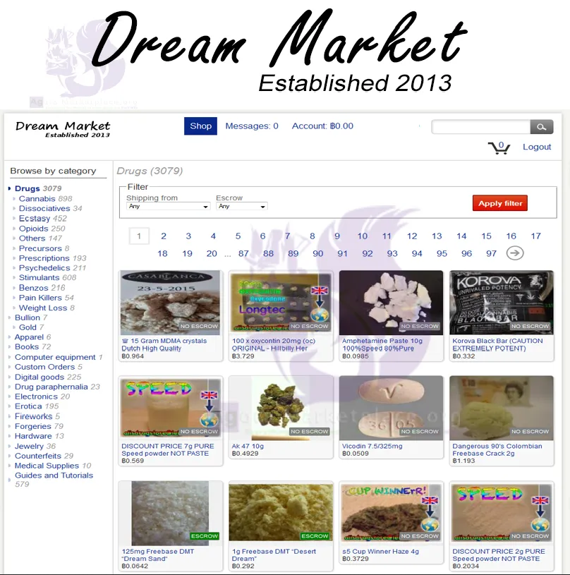
Market Navigation
Preference is a legal and regulated supply (FPP has offered this if sanctioned).
Community-based drug user groups are in a unique position to navigate illicit markets on behalf of the club.
Internet-based (Darknet) drug markets introduce an additional level of regulation into drug markets which can increase safety and consistency.

Slide 15
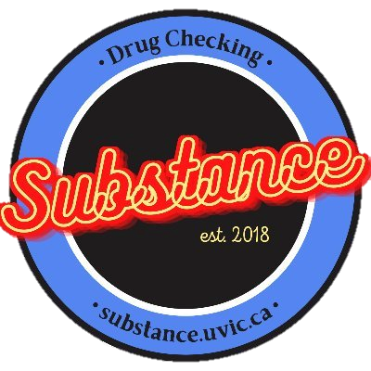
Quality Control
Substances are tested with fentanyl/benzo test strips, FTIR, and mass spectrometry every time.
Exponentially increases the effectiveness and impact of drug checking initiatives.

Slide 16
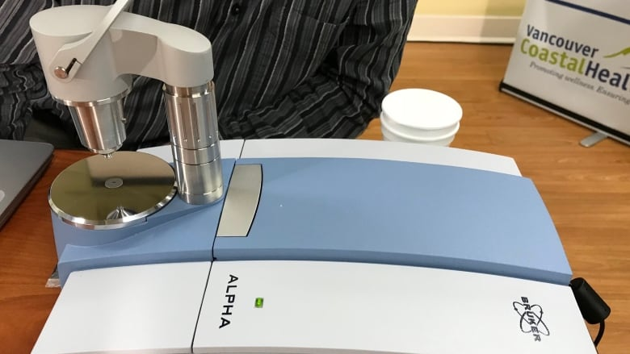
Limitations of FTIR Testing
Detection Limit of 5%
Unable to differentiate similar molecules (E.g. 6-MAM and heroin).
Analysis is often subjective.

Slide 17
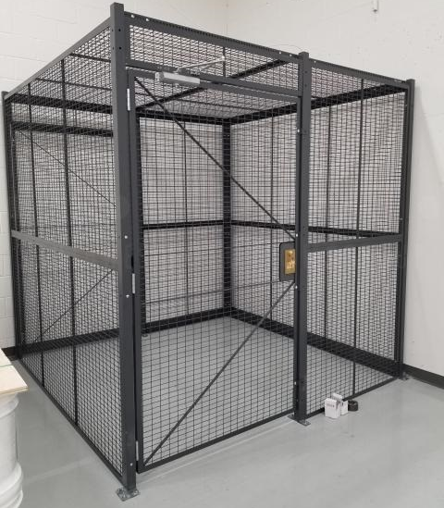
Storing the Substances
Substances are to be stored in a secured safe.
Tracked with daily counts to ensure there is no theft, loss or diversion.
Records would also be kept on any dispensations.

Slide 18
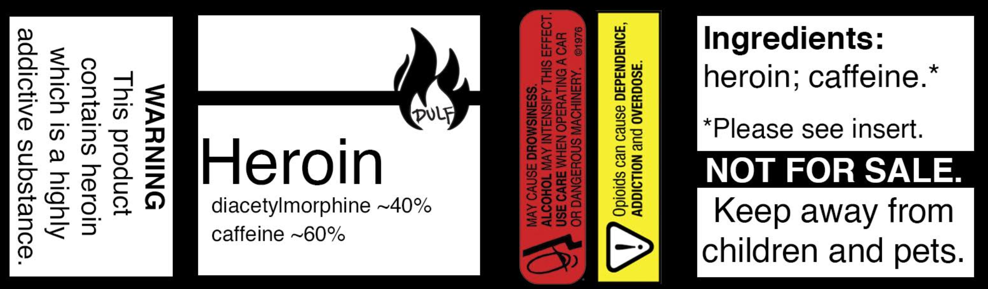
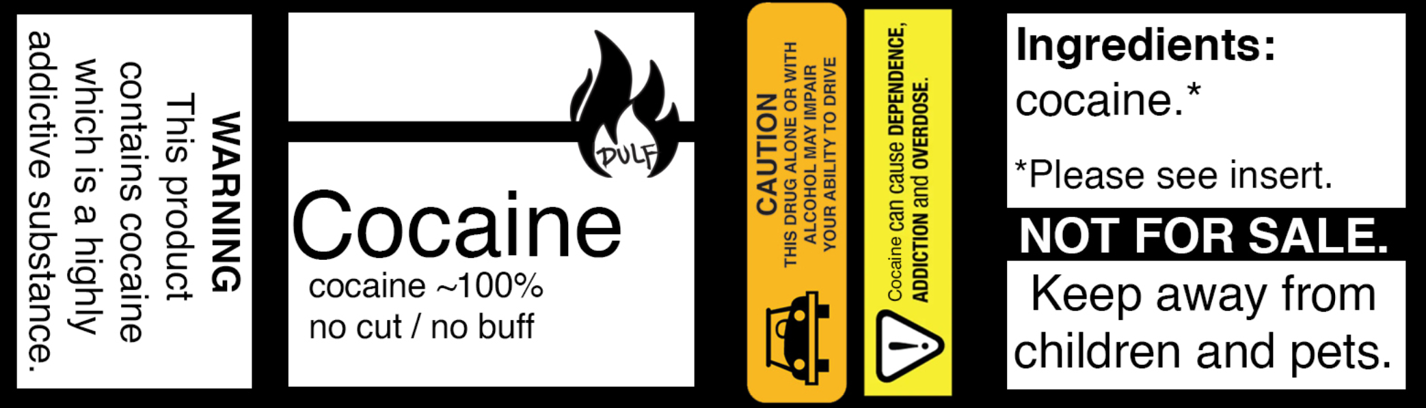
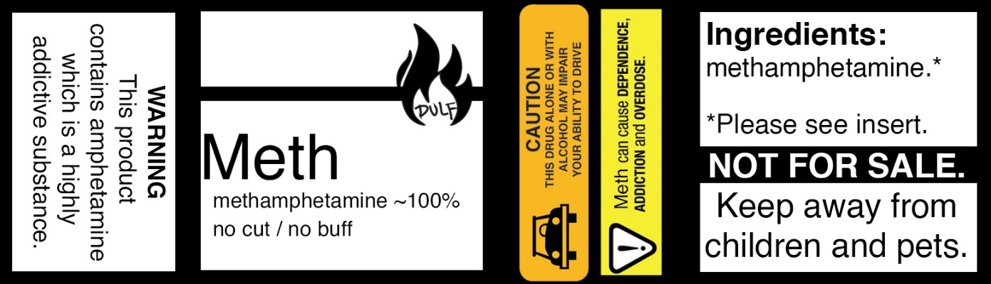
Labels and Packaging

Slide 19
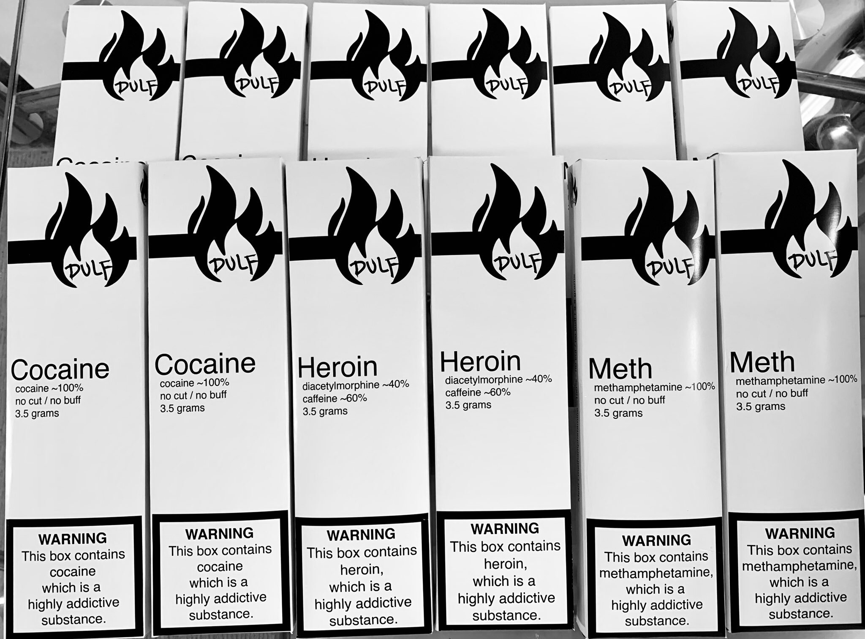

Slide 20
Distribution
For the compassion club to remain cost efficient, substances must be provided at-cost to club membership.
Substances at larger actions are obtained through private donations, so they are provided free-of-cost.
Due to dependence on illicit markets, future prices will reflect street prices if there is no other viable option.
  Bulk-purchase allows compassion clubs to leverage economies of scale.

Slide 21
Outcomes
DULF currently collects basic data on all drugs that have been distributed.
DULF has distributed over 1200 doses with no know overdoses.
With further funding, DULF will engage in a deeper evaluative study of the impacts of a real safe supply.

Slide 22
What You Can Do to Help
Donate to our Sustainer Donor Program at https://www.dulf.ca/sdc
Get a letter of support from your organization or institution.
Sign our petition at: https://www.change.org/p/health-canada-approve-dulf-compassion-club-and-sect-56-applications
Write or reach out to your MP or MPP and express support for DULF’s activites.
Volunteer at one of our actions.

