Slide 1

Safe Supply 101:
Making the leap from medicalization to drug user liberation
Corey Ranger
October 14, 2021
National Safer Supply - Community of Practice
Notes:
Welcome.

Slide 2
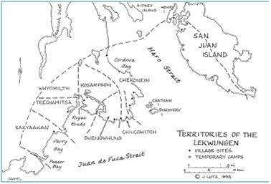
Notes:
There is a link between colonization (which is fundamentally a process of violence and disconnection that operates at multiple levels, both historically and currently) and the topics we’re here to discuss: namely the war on people who use drugs on the land commonly referred to as “Canada”, and the disproportionate impact of criminalization, the overdose crisis, Hepatitis C, and HIV/AIDS on Indigenous peoples as an ongoing impact of colonization.

Slide 3

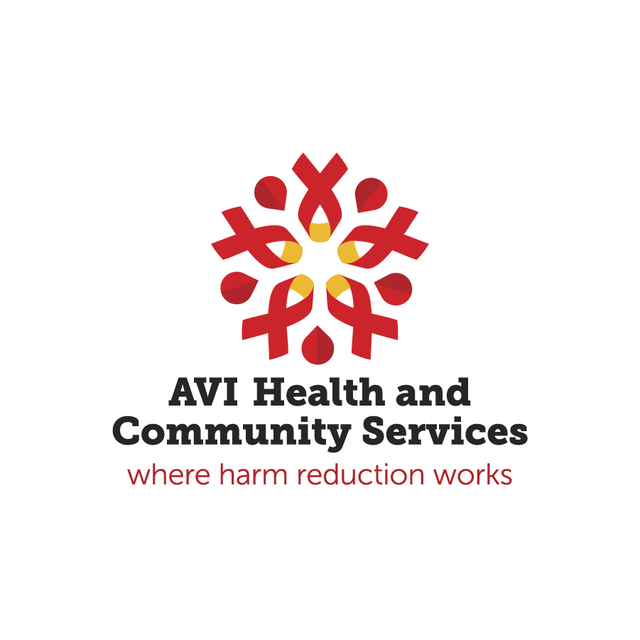
This presentation is made possible by people with lived/living experience of drug use sharing their knowledge and experience with paid educators. Without their generosity, this presentation would be impossible.
Notes:
Contributions.

Slide 4




GOALS
FOR TODAY
Harm Reduction 101: Prohibition + Harm Reduction
Underpinning Philosophy
Safe Supply Basics
The Victoria SAFER initiative
Notes:
Our plan is to briefly recap the principles of harm reduction, then talk about the many ways harm reduction is implemented.
We will then move beyond the what, and focus on the how. More so, what is it that makes harm reduction so effective in improving the health and well-being of marginalized populations.
Next we will cover the foundations of safe supply and we will finish up by discussing one example of a safe supply program, the Victoria SAFER Initiative.

Slide 5
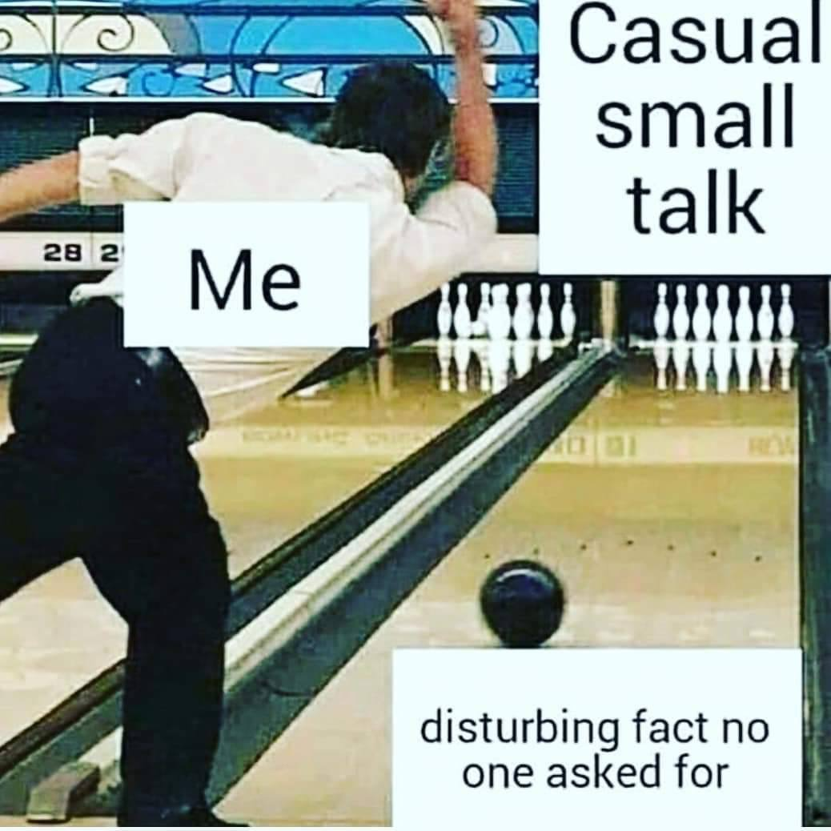
Notes:
A bit about me.

Slide 6
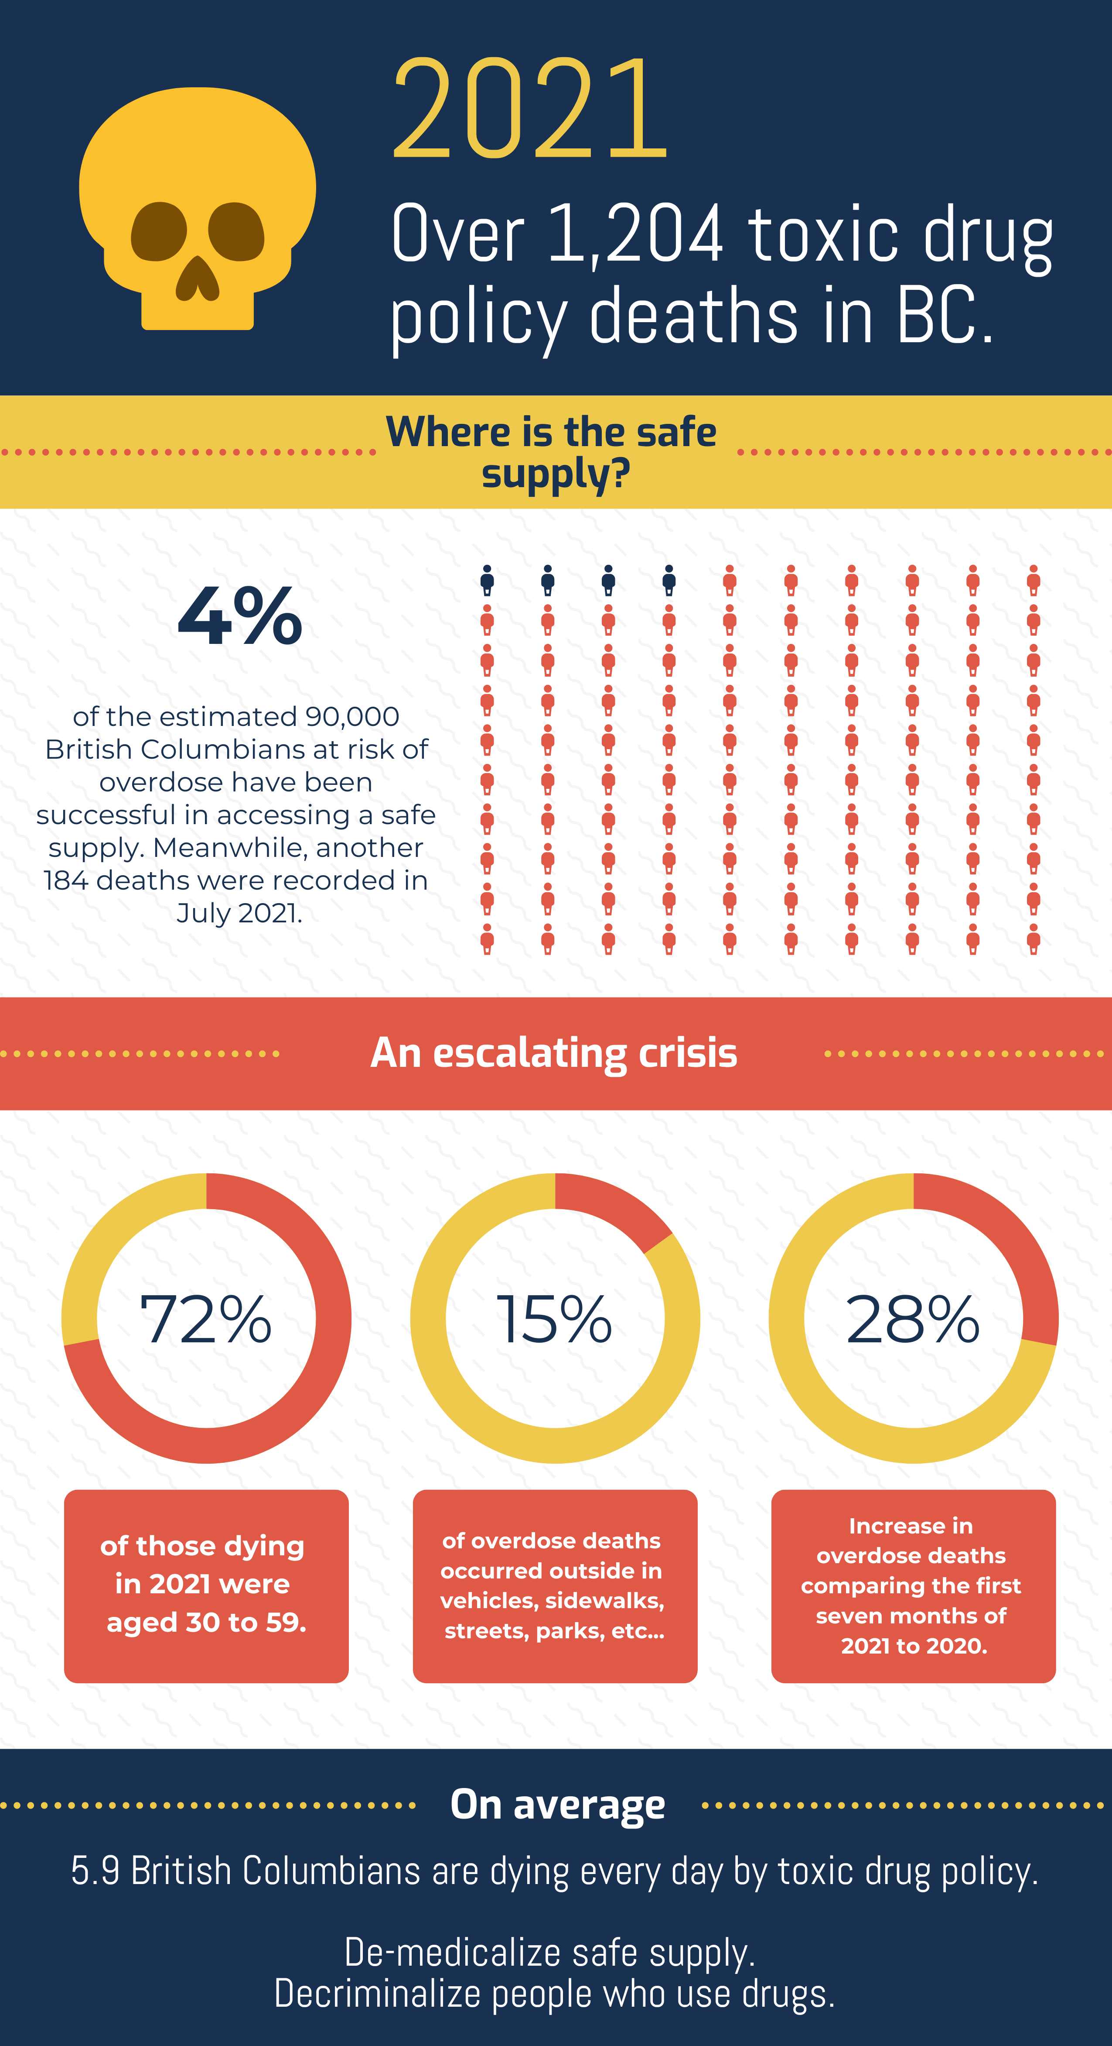
Notes:
Where is safe supply in BC

Slide 7
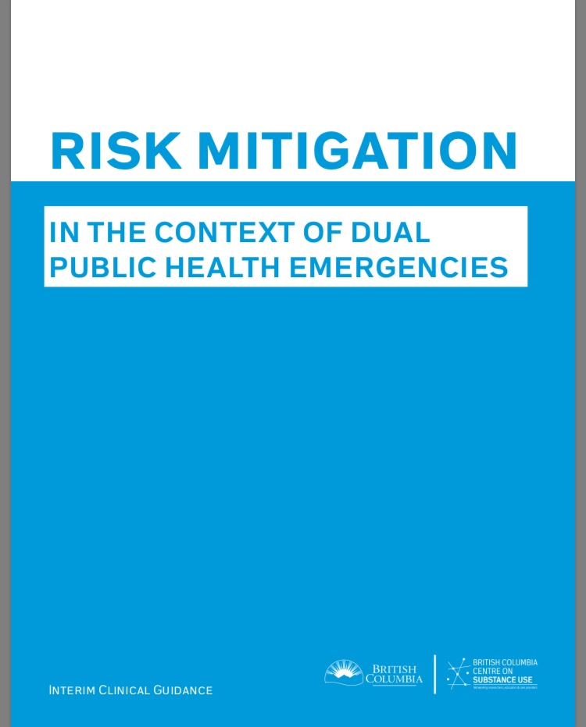
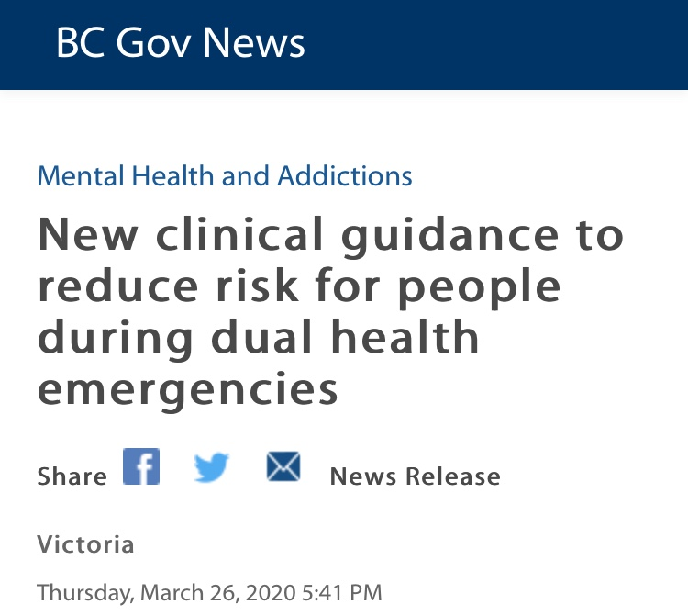
Notes:
A short history of safe supply in B.C..
Rooted in data from Naomi and Salome trials as well as heroin assisted therapy in Switzerland and the Netherlands
iOAT and TiOAT options have expanded across Canada.
Then COVID and the RMG rollout.

Slide 8
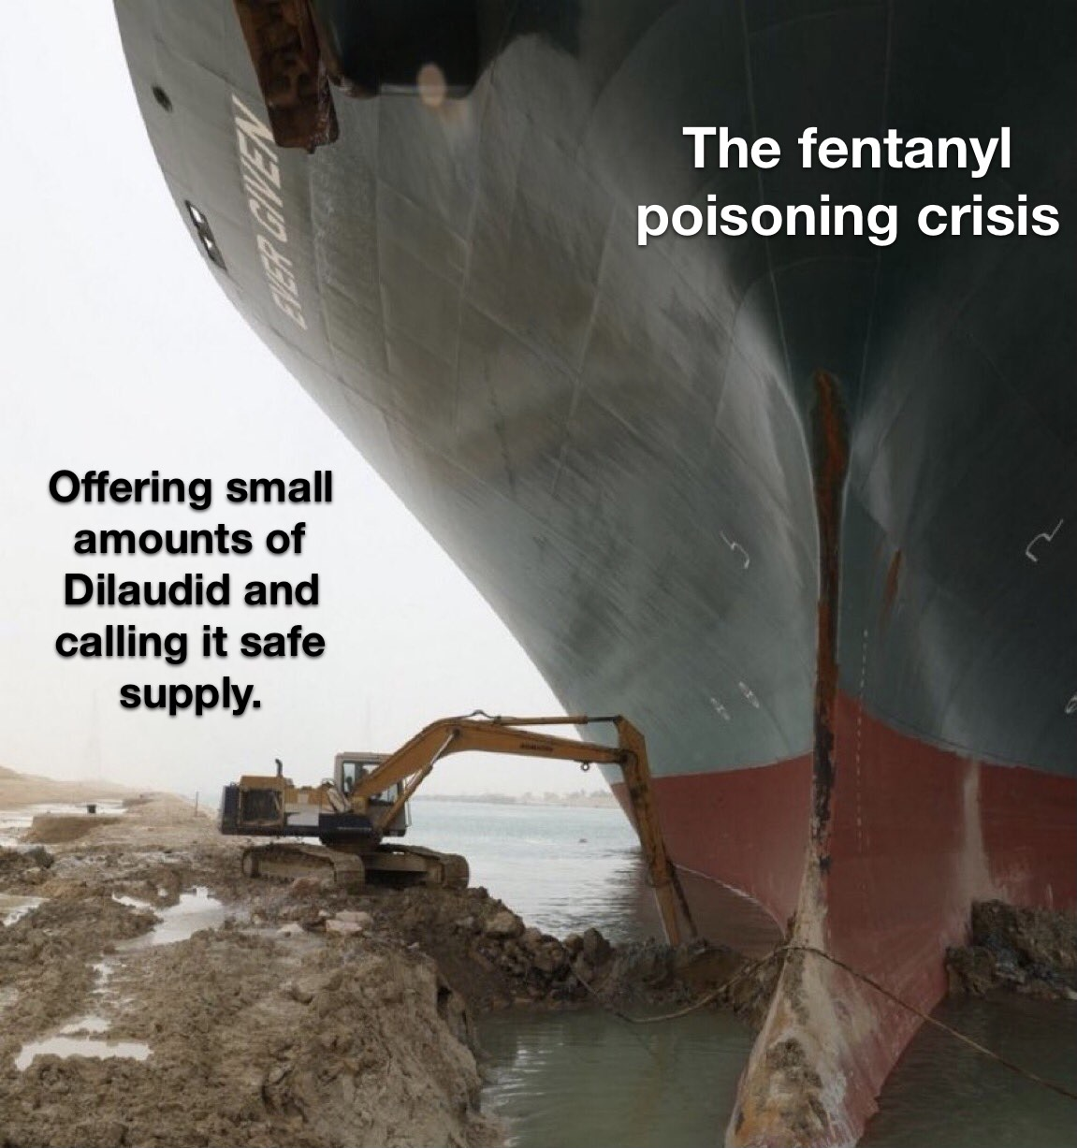
Discussion
Notes:
What have been your experiences to date, supporting someone to access a safe supply?
What are the biggest challenges you see with safe supply?
What do you want to know more about safe supply?

Slide 9
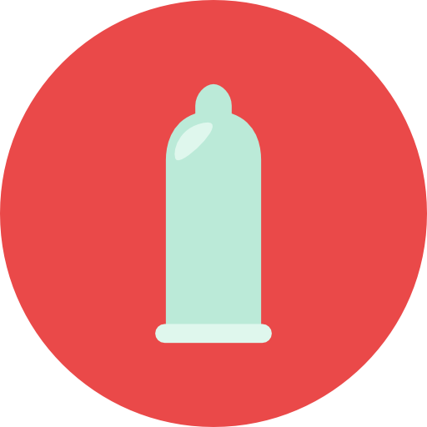
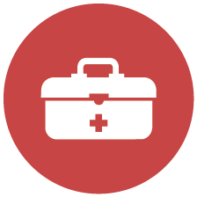



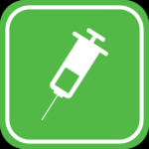




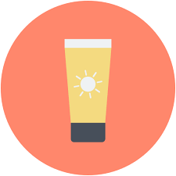

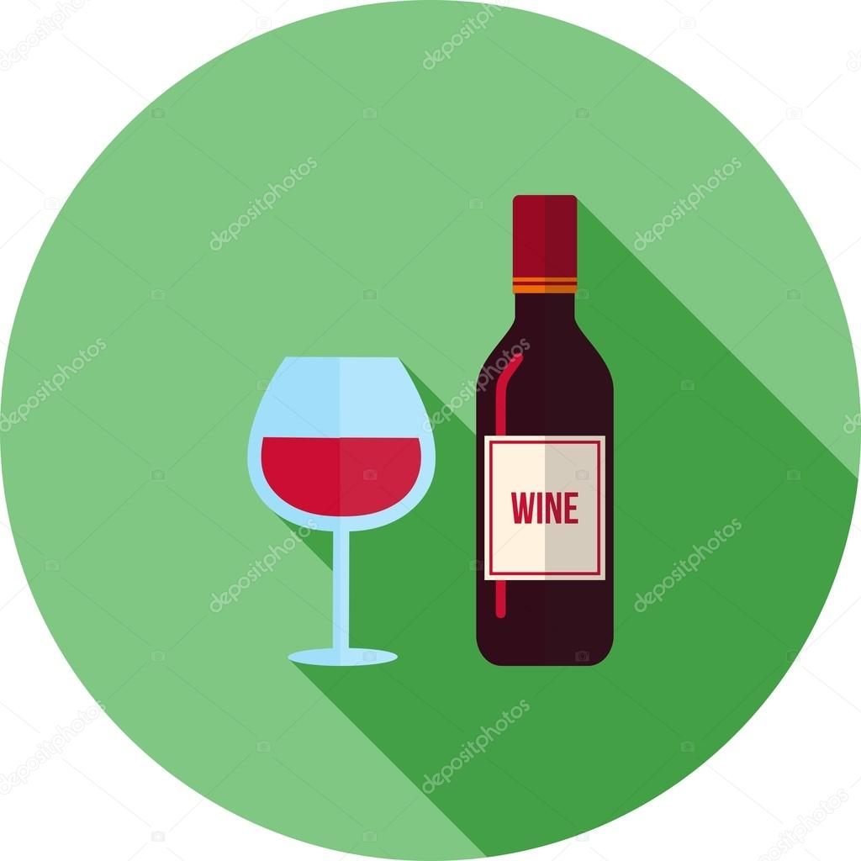



The many faces of Harm Reduction
Notes:
Safer Sex Supply Distribution
Harm Reduction Supply Distribution
Testing & Treatment of STBBIs
Naloxone & Overdose Education
Car Seats and seatbelts
Check-stops and designated driver program
Sunscreen
HPV Vaccination
Supervised Consumption Services
Managed Alcohol Programs/Exchange
Safety Planning-drug use setting, domestic violence
Safer Piercing Kits
Drug Checking Kits & Services
Fact-Based Drug & Sex Education
Safer sex supply – condoms, dental dams, lubricants (available at HIVCL), reduces STBBIS, unplanned pregnancy, etc.
HR supplies – for injection = needles, cookers, tourniquets, alcohol swab, filters, barrels, sharps containers, also supplies for inhalation = pipes, tubing, snorting = new straws – reduce both HIV and HCV transmission from sharing used equipment. Where can you get this? Also primary function of our MH location. Other harms of injection – soft tissue infection, sepsis, PE, endocarditis, etc.
Testing and Tx – having an untreated STI increases risk of other STIs, also long term consequences of untreated STIs
Naloxone is an opioid reversal drug that can prevent overdose from opioids such as heroin, oxycodone, fentanyl, etc.
The take-home naloxone program is a prime example of the increasing value of harm reduction programs. Initiated in Alberta by Streetworks in 2008. Province-wide programming began in 2015 as a response to emerging Fentanyl crisis, we were 1 of 7 organizations across AB to roll it out. Unique peer-to-peer initiative that empowers individuals at risk for opioid OD. Near exponential growth in fentanyl related overdose deaths in Alberta (117 in 2014, 257 in 2015, 343 in 2016) a result of changing policies and altering the chemical formulary of oxycodone (now oxyneo). All populations and demographics have been impacted by the rise of fentanyl across Canada. Naloxone distribution includes education about overdose prevention.
SCS – Talk about language of SCS vs SIF. Explain what the service is – safe place, how to inject/education, supervision, access to Tx, don’t use alone, rapid intervention in emergency situations, etc. – supervised/staffed by mostly nurses (in Canada so far) could also include doctors, peers, social workers, harm reduction worker. Consumption includes injection and smoking/inhalation. Service means it can be integrated into other services, hospitals, clinics, mobile, etc. Only part of the solution.
A 2016 systematic review found: 70% less likely to share needles than non-InSite users, 33% more likely to seek treatment than non-Insite users. No increase in drug-related crime in 10 years (Australia site), drug trafficking arrests, assaults, or robberies
Decreased vehicle break-ins, injecting in public spaces (i.e. parks, alleys), decreased syringes discarded in public places, decreased syringe sharing/reusing, greater condom use and better injection practices, greater referrals and tx initiation. Zero overdose deaths in SCS ever.
Incremental net savings of $14 – 60 million over 10 years. Cost benefit ratio save $5.12: for every $1 spend on SCS
According to Vancouver Coastal Health (2016) – 18,000 people registered with Insite, 3.5 million visits, 40,000 clinical treatment visits and 4,922 overdoses with 0 deaths.
Currently there is a provincial needs assessment happening in Alberta, to examine the needs for SCS, as well as where and how they should be implemented to be most effective.
Opioid replacement therapies, methadone, also suboxone (buprenorphine & naloxone – no high, cannot be injected, reduced risk of overdose, limits withdrawal symptoms, must be in mild withdrawal to start, easier to get “carries”), heroin trials (NOAMI and SALOME), etc. None covered by Alberta Health, Suboxone more expensive than methadone. Also there’s a managed alcohol program at Alpha House – part of housing.
Sex workers – Bad Date sheet, harm reduction tips, and safety plans
Piercing kits – for Hep C transmission (The Alex youth Centre and Safeworks) – not a risk for HIV but rather for HCV
Drug checking – limited availability particularly useful for recreational drug users, unsure of effectiveness in chronic drug users, recreational use is different than addictions.
Education – this is huge!!
What kind of harm reduction messaging have you used in practice? (start low – go slow, do a test shot if it’s a new batch, don’t use alone, don’t mix drugs, how to access naloxone or needle distribution, etc.)
First SCS – 1980s and early 1990s in Germany, Netherlands and Switzerland. Now more than 90 sites globally. Two SCS in Canada, both in Vancouver, InSite – 2003 and Dr. Peter Centre - 1997 (integrated as part of a health care facility for people with HIV). Also around 20 pop-up overdose prevention sites – supervised but more loose than InSite/Dr.Peter Center, can share drugs, can help each other inject, can smoke
Three new SCS have been approved in Montreal, opening soon, many other Canadian cities are waiting for approval – Vancouver, Victoria, Surrey, Toronto, Ottawa, Montreal (mobile unit). Calgary developing an application.
327% increase in overdoses in Canada since 2008 (HRI, 2016)
Canada is big producer of empirical evidence for SCS, 68% of articles in a 2016 systematic review were from Vancouver: (Potier et al., 2016)
Heroin, Cocaine, Opiates and Amphetamines most commonly used at SCS
80% are HCV+, 2-30% HIV+, most commonly male, 30-35 years old, housing insecurity and homelessness, hx of incarceration, 10-39% have sex work involvement.
Harm reduction became a pillar of our National Drug Strategy in 1992, 1996 Controlled Drugs and Substances Act (CDSA) Section 56 allowed for exemptions for SCS. 2003 National Drug Strategy renewed with harm reduction, but then in 2006 – Conservatives, 2007 anti-drug strategy which removed and opposed harm reduction – Canada became a strong opponent of harm reduction in the global realm. Exemptions provided along the way until 2008 when BC supreme court said should stay open, then supreme court of Canada agrees. Bill C-2 passed and Liberals elected in 2015 – meaning 26 criteria (including community consultation) for 1 year exemption, lengthy process. Government to establish 5 criteria and develop framework. 2016 – harm reduction now part of national drug strategy again.
Harm reduction falls within normal scope of practice of RN, unique practice and care. Insite developed it’s own nursing framework! (2009).
Drug use is criminalized – biggest barrier to health care and harm reduction for drug users – calls for decriminalization.
The realities of an unregulated drug market – fentanyl, people have no control or idea what they’re buying.
Improving SCS – 30-60 mins wait times, not open 24hrs, sharing drugs not allowed, inhalation not implemented, assisting with injection not permitted at this time. High prevalence of assisted injection amongst high-risk people, youth, women and people with disabilities – they may have negative effects from asking others for help (must sell drugs, sex, etc.)

Slide 10
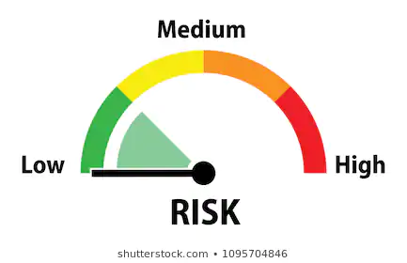
What behaviours carry risk in our lives?
Notes:
Harm Reduction accepts and recognizes that these risks will continue to occur, and risk is a normal part of human life—so rather than condemning those engaging in risk-taking behavior, harm reduction seeks to mitigate the harms associated with that specific behavior.
Essentially, risk taking behavior occurs on a continuum ranging from very low risk activities (e.g. driving to work in the morning) to high risk activities (e.g. injection drug use, unprotected anal sex, extreme sports).
Option 1: Stop behaviour / abstinence
Option 2: Make it safer / harm reduction
Ask audience Qs
Helmets, lifejackets, parachutes, immunizations, condoms, seatbelts, birth control, PPE, sunscreen, flight safety,

Slide 11

What is Harm Reduction?
Public Health Approaches
Indigenous Approaches
to Harm Reduction
Drug User Liberation
Notes:
Point about different approaches to harm reduction, interrelationship between some, many differences
-Want people to be aware of other approaches and to check them out
“Mainstream harm reduction practices, such as naloxone distribution and opioid substitution therapies, have been proven to save lives; however, they are narrowly focused on substance using behaviours and do not address the broader social and system-wide issues that contribute to and intersect with substance use for Indigenous peoples in the first place. For Indigenous communities, harm reduction = reducing the harms of colonization. This means that Indigenous harm reduction is not tethered to the use of substances. Instead, Indigenous harm reduction is a way of life, embedded within traditional knowledge systems that see the spiritual world, the natural world, and humanity as inter-related. Given that these knowledge systems and the way of life they give rise to have been disrupted by the historic and on-going impacts of colonialism, decolonizing policy and program environments to support the restoration of these relationships is critical to restoring the health and wellness of Indigenous communities.”

Slide 12
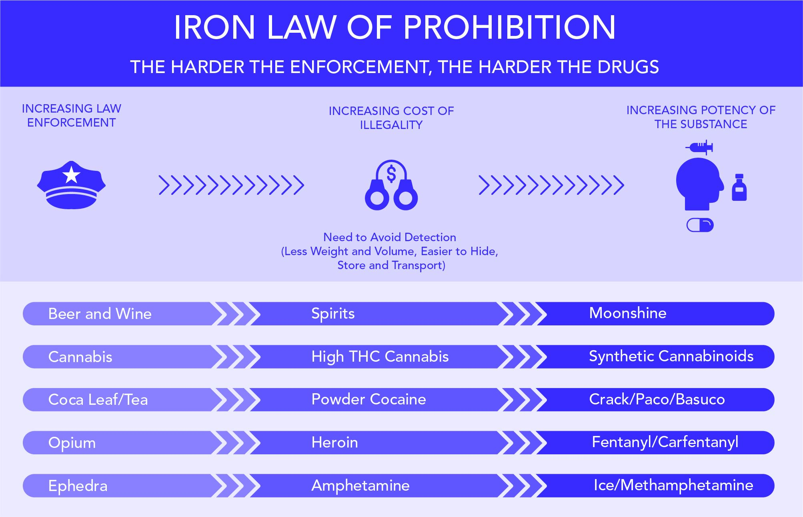
The War on Drugs
Notes:
Prohibition of substances and criminalization of people are systemic forces that oppress people who use drugs and are often referred to as the War on Drugs.
As people doing harm reduction work, we have to understand that we are working against the backdrop of this war, which is really a war on people, and as we all know, is killing people in unprecedented numbers. The ongoing criminalization of people who use drugs pushes people toward harm in multiple ways and indeed represents one of the biggest harms associated with drug use – much more than the drugs themselves.
Our drug laws still make criminals out of people who use certain substances which only reinforces a pervasive value system that regards harm reduction as ‘enabling’ people to behave in intolerable ways.
What seems to still not be well understood is that making substances illegal and criminalizing people for using substances actually does nothing to stop people from using them.
The reason for this is that many people who develop a dependence relationship with substances do so because they are medicating some kind of pain. Commonly this pain is rooted in trauma, abuse, injury or illness, difficulties with mental health, or some other unmet physical or emotional need.
Of course, people also use substances for pleasure, fun, spirituality, personal growth and creativity, and unfortunately they also face potential harms related to the fact that we criminalize some substances which feeds unregulated markets and an unpredictable supply that can easily become toxic and dangerous.
There are many great resources available about the War on Drugs and the policies that create harm for people who use drugs. Check out
our resource list which includes ‘The Drug War Reading List’ by Zoe Dodd.

Slide 13
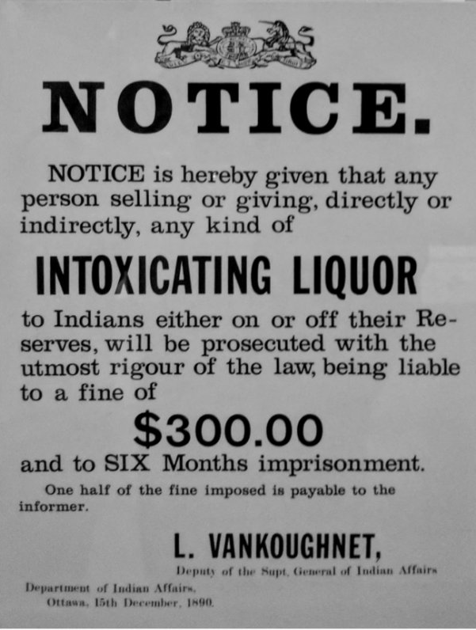
Colonization & The War on Drugs
Notes:
One thing that the last video doesn’t cover, in part due to its US focus, is the link between colonization and the war on drugs, and the link between racism and the war on drugs in Canada.
Canada’s first drug prohibition was directed at Indigenous peoples.
Alcohol was introduced to Indigenous people by British, French, and US settlers through colonization.
When colonizers began to forcibly convert Indigenous people to Christian relations, morals and values, they also advocated abstinence and believed that prohibition would mean there would be less inter-racial mixing between white and Indigenous peoples and less mixed-race children.
While alcohol prohibition had a short history in Canada, it was imposed on Indigenous people for over a century. Prohibition served as a legal mechanism to control Indigenous peoples and nations right up until 1955.
As with other forms of prohibition, it did not stop people from drinking, but encouraged covert and dangerous drinking practices, illegal consumption and selling, covert use, as well as enduring stereotypes and legal discrimination against Indigenous people that continue today.
We know that Indigenous people and people of colour are disproportionately impacted by the war on drugs both locally and globally.
For example, in 2015/2016, Indigenous adultsNote22Note23 were overrepresented in admissions to provincial and territorial correctional services and they accounted for 26% of admissionsNote24 while representing about 3% of the Canadian adult populationNote25 (Table 5). Indigenous women accounted for 38% of admissions of women to provincial and territorial sentenced custody.
(Taken directly from: https://www150.statcan.gc.ca/n1/pub/85-002-x/2017001/article/14700-eng.htm (report on Correctional Services in Canada for 2015/2016))
We would recommend the book ‘Busted: An Illustrated History of Drug Prohibition in Canada’ by Susan Boyd as a great resource for more information about where Canada’s drug laws came from. It covers the roots of prohibition in colonization starting in the 1800s and earlier, all the way to present day and the legalization of cannabis.

Slide 14
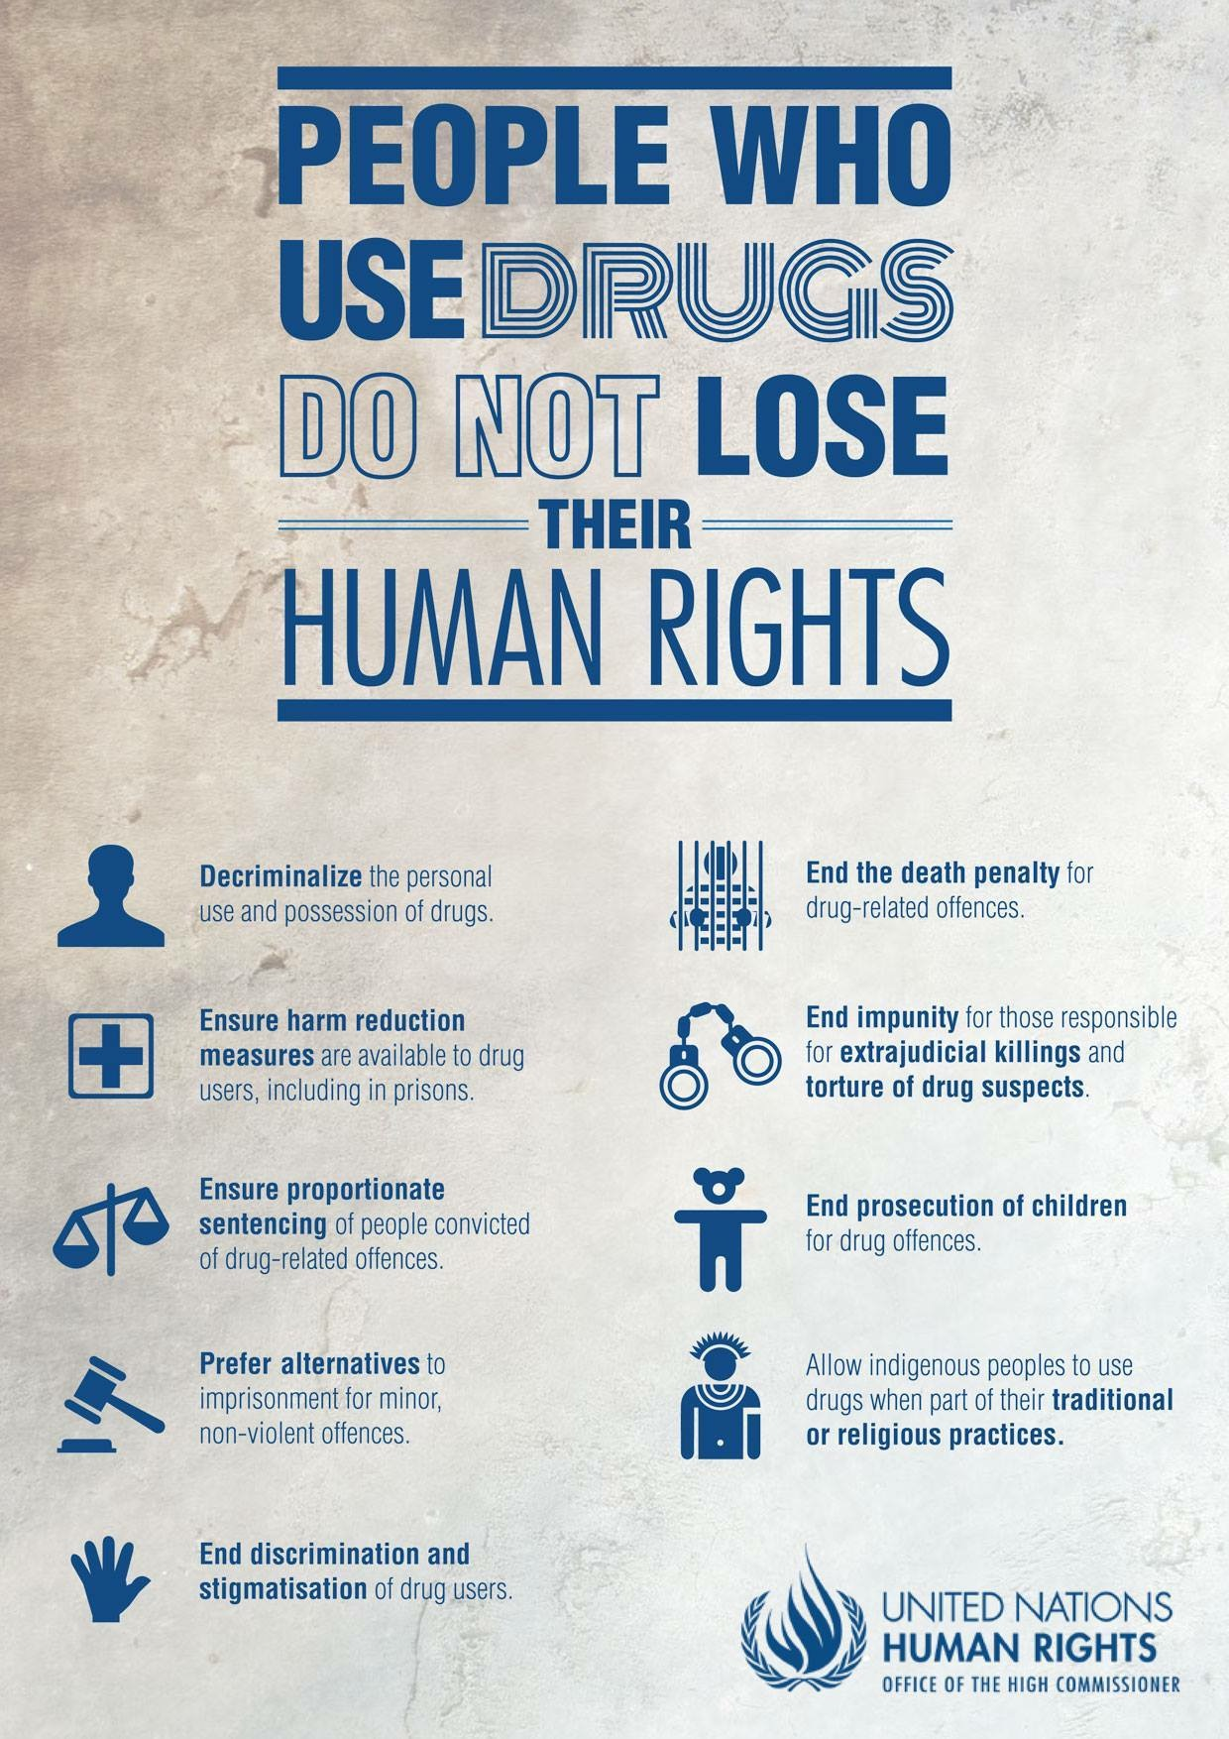
History of the Harm Reduction Movement
Notes:
Harm Reduction can be traced back to people organizing in the 1960s against the legal suppression of drugs, and to places in Western Europe, the UK and New York City in the late 1970s and early 1980s.
An example of one of the earliest harm reduction programs was the opening of the first needle exchange program in Amsterdam in 1984.
People who were using heroin used to buy their syringes from a particular pharmacy that eventually shut down.
People in the community were worried about injection-related garbage and the growing concern that the new virus, HIV, was not only affecting gay men but also people who injected drugs.
In response to the pharmacy shutting down, drug users organized to set up a program where people could not only access needles but also bring their used needles in to reduce the amount of garbage that was being left around the city.
A couple of years later, an illegal supervised injection site was opened in Amsterdam and the first legal site opened in Switzerland around the same time in 1986.

Slide 15
Activity
What are the obstacles to harm reduction practice in your work?
2) How might harm reduction be further incorporated into your work?
3) How do you practice harm reduction in your workplace?
Notes:
Reflect.

Slide 16
Harm Reduction Principles and Values
Principles: Rules or beliefs that govern our actions.
Values: Qualities or standards that govern the behavior of a person.
Principles are based on a person’s values; values are the foundation for principles.
Notes:
People who work in harm reduction often do so because they see some of their personal values reflected in the values and principles of harm reduction. Whether you are someone with personal experience of drug use, or you are coming to this work without that personal experience, it’s the values of harm reduction that can often unite us in solidarity, and that’s key to the health and future of harm reduction as a movement and as a practice that is rooted in our hearts and not just our heads.
Too often, harm reduction is divorced from its radical potential as a social justice approach. When we lose sight of the deeper meaning of harm reduction and the values at its core, we risk relating to one another in ways that are not really in line with harm reduction practices at all, or are limited in the extent that they actually reduce harm.
We’re going to spend some time talking about the principles and values of harm reduction, and then we’re going to ask you to reflect on what these principles actually look like in practice.

Slide 17
Principles of Harm Reduction
1. Drug use is a human behaviour that many people across the world are unwilling or unable to stop.
2. People who use drugs do not lose their human rights due to their drug use.
Notes:
Harm reduction is based on a set of principles or concepts that make up the foundation of the philosophy, the movement and the practices. We will spend a bit of time talking about these principles and then link them to our own values and how we do our work.
The 9 principles we’re going to briefly go through were compiled and adapted from the Harm Reduction Coalition in the States and from Harm Reduction International. We have consolidated them and tried to translate them into less jargon-y language.
1. Drug use is a human behaviour that many people across the world are unwilling or unable to stop.
2. People who use drugs do not lose their human rights due to their drug use.
We are entitled to rights to life, the highest attainable standard of health, social supports, privacy, freedom from arbitrary detention and degrading treatment, and others. Treating people who use drugs, their families and their communities with dignity and compassion honours their human rights.

Slide 18
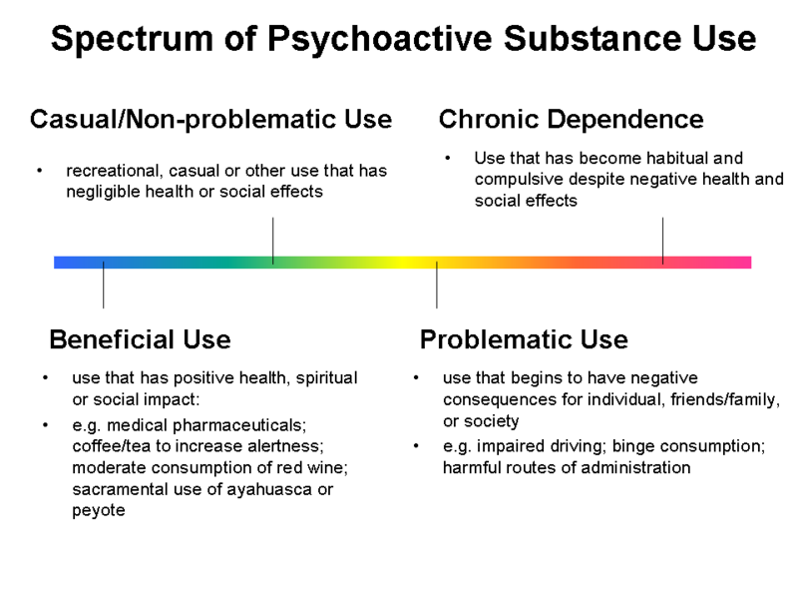
3. People use drugs for many different reasons and in many different ways.
Notes:
https://www.health.gov.bc.ca/library/publications/year/2006/followingtheevidence.pdf
3. People use drugs for many different reasons and in many different ways.
For example, this model demonstrates the concept that drug use may occur on a spectrum. We know that regardless of what substance someone is using or how, only a small percentage of people who use drugs experience ‘problematic use,’ and we know that a harm reduction approach can help people maximize the benefits they get from using drugs.
What is your response to this model? Are there elements missing for you? How could we further complicate/problematize this model?
What do you think is the difference between substance use and addiction?
Carl Hart on the definition of addiction: https://www.youtube.com/watch?v=iWCjYxtRBXE (2:37 minutes) and/or Carl Hart on drug use & addiction & myth of a drug-free world more broadly: https://www.youtube.com/watch?v=nCJ3HviSa4E (5:15 minutes)

Slide 19
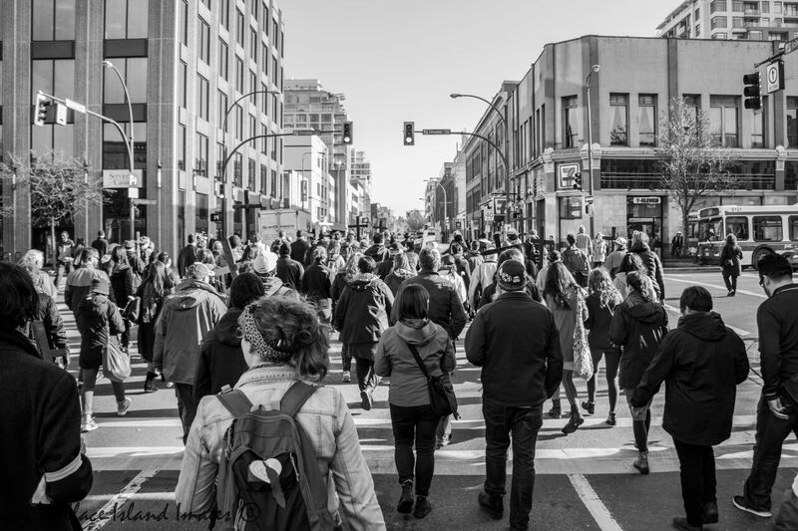
4. Harm reduction is
evidence-based.
Notes:
4. Harm reduction is evidence-based. Harm reduction policies and practices are informed by a robust body of evidence that show these interventions have strong positive impacts on individual and community health.

Slide 20
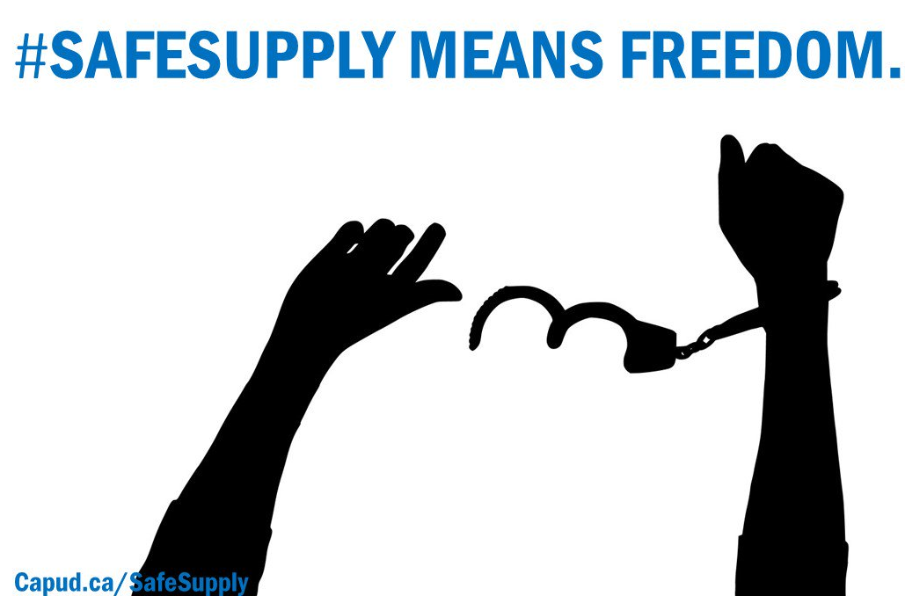
5. Harm reduction is committed to meeting people ‘where they are at’ without judgement.
6. Options for prevention, care and treatment must be evidence-based, high quality and non-coercive.
Notes:
5. Harm reduction is committed to meeting people ‘where they are at’ without judgement and without the use of stigmatizing language that perpetuates harmful stereotypes and creates barriers to health. Harm reduction is concerned about quality of life for everyone, not necessarily ending drug use.
6. Options for prevention, care and treatment must be evidence-based, high quality and non-coercive. Many people who use drugs do not need treatment and those who want support such as treatment should have access to options that do not require abstinence.
What’s an example of non-coercive service? How could we expand treatment options to be more diverse and accessible to a broader range of needs?

Slide 21
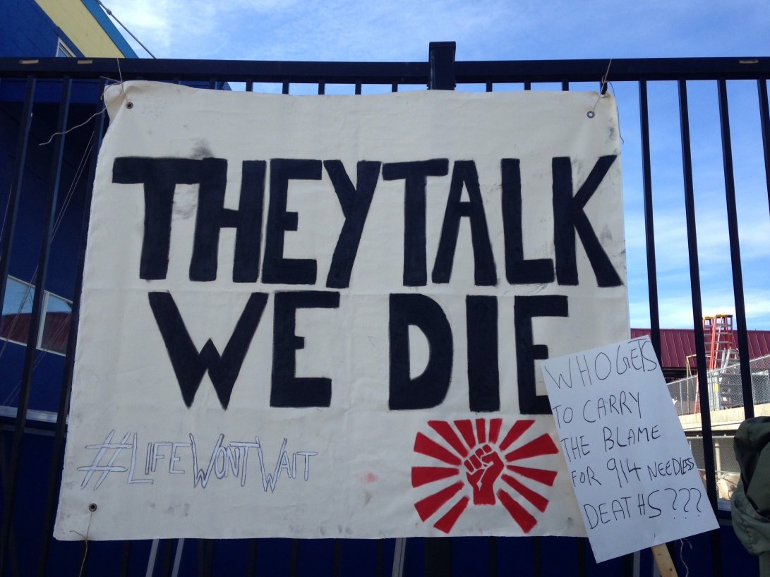
7. People who use(d) drugs must be involved in designing, implementing and evaluating programs and policies that serve them.
Notes:
7. People who use(d) drugs must be involved in designing, implementing and evaluating programs and policies that serve them.
Meaningful involvement of people who use(d) drugs in designing, implementing and evaluating programs and policies that serve them is central to harm reduction.
“Nothing about us without us” is a commonly used phrase that affirms that people who use drugs are the experts in reducing harms associated with drug use.

Slide 22
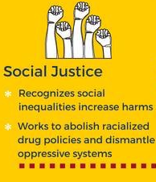
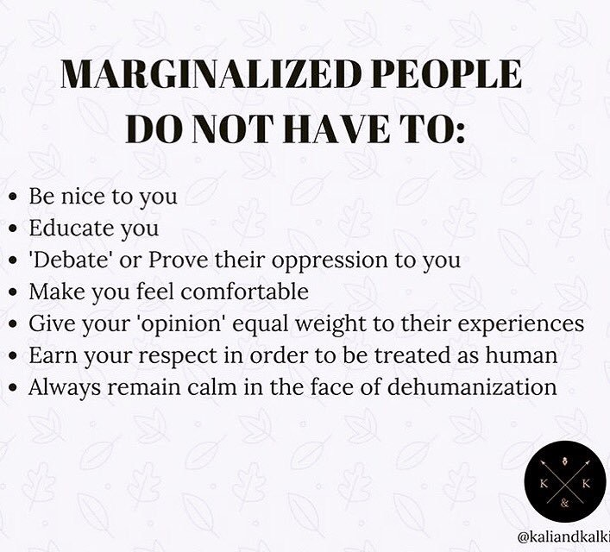
8. Harm reduction is rooted in a commitment to social justice.
Notes:
8. Harm reduction is rooted in a commitment to social justice and addressing inequities that exclude people who use drugs from the supports they need due to gender identity, sex-based discrimination, economic status, colonization, racism, stigma, trauma and other social oppressions.
What are forms of oppression that might create harm?
How might these forms of oppression create more harm/what might their impact be on drug use?
-eg. trauma comes from oppression
-What are some harm reduction policies that we might put in place to mitigate the effects/harms of these oppressions?

Slide 23
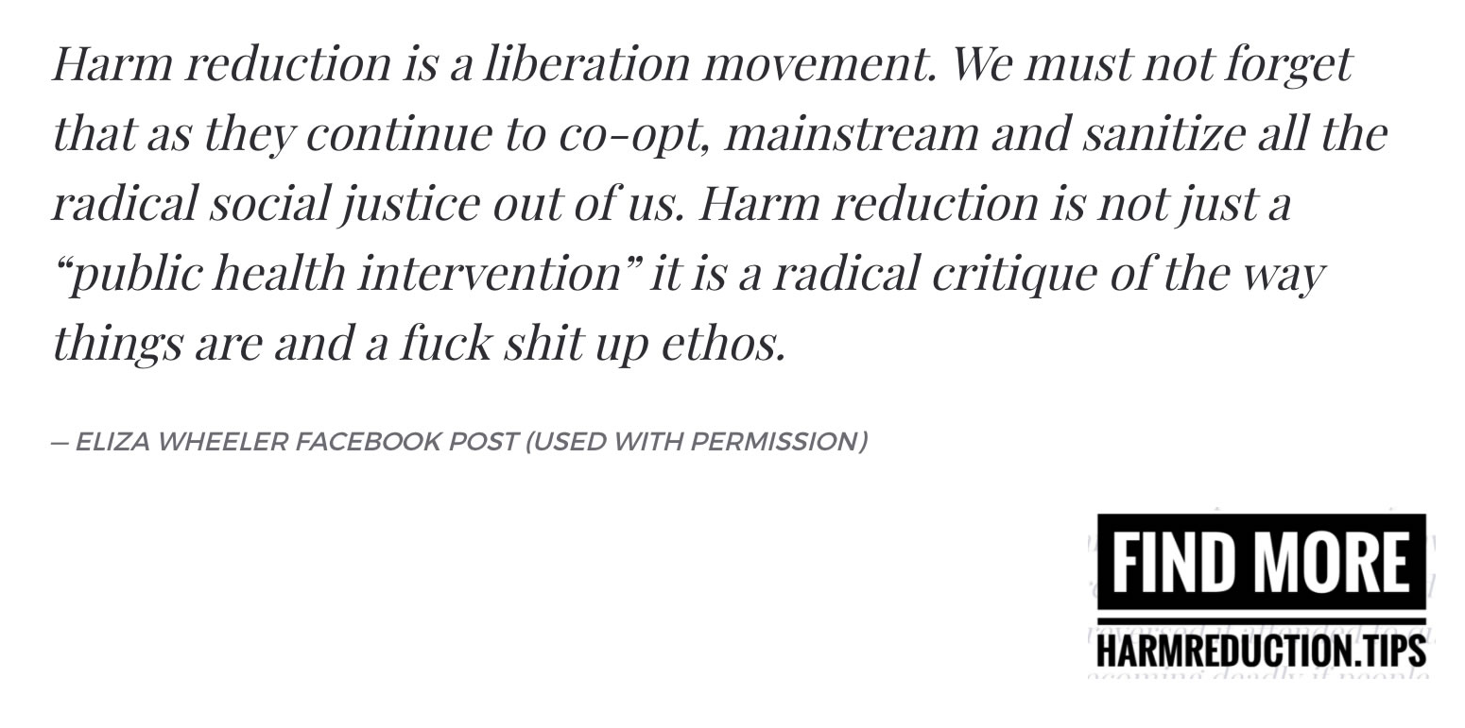
9. Harm reduction challenges policies and practices that cause harm.
Notes:
9. Harm reduction challenges policies and practices that cause harm.
Many policies and practices intentionally or unintentionally create and exacerbate risks and harms for drug users, including the criminalisation of drug use, discrimination, abusive and corrupt policing practices, restrictive and punitive laws and policies, the denial of life-saving medical care and harm reduction services, and social inequities. Harm reduction challenges laws, policies and practices that contribute to harms experienced by people who use drugs.
This movement asserts that non-judgmental and practical, integrated services can reduce many of the harms of drug use, many of which are not specific to the drugs themselves; rather, they stem from a lack of legal, unadulterated drugs and access to new equipment.
Drug prohibitionist policies and laws are seen as negatively contributing to and exacerbating the factors that they claim they will reduce. For example, criminalizing needle distribution negatively impacts HIV/AIDS and Hepatitis C infection rates.

Slide 24
Reflecting on Harm Reduction at work…
Notes:
How do we take the value-based principles of harm reduction and put them into practice? Depending on where you work, you may be supported more or less by the policies of your agency, the support of your supervisors, and the solidarity from your coworkers. You may work in a setting where harm reduction is well understood and forms the foundation of your work at all levels. You may work somewhere that distributes harm reduction supplies but doesn’t really get into harm reduction beyond that. Or, you may work in a setting where abstinence is required of service users and harm reduction is not at all part the working culture, or it’s viewed as separate.
Regardless of the setting in which you work, there are ways that you can practice from a place of harm reduction in your interactions with other people, and linking harm reduction principles to your own values might also be a way to introduce the concepts in a more accessible way to your coworkers and managers.

Slide 25
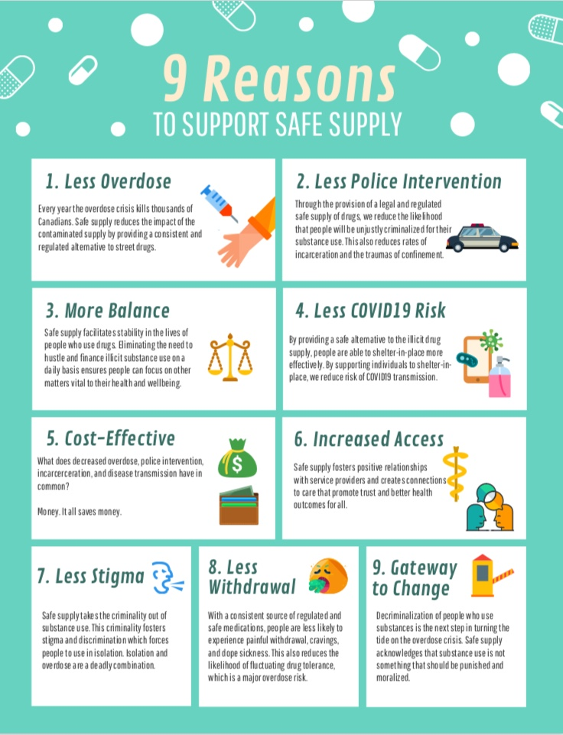
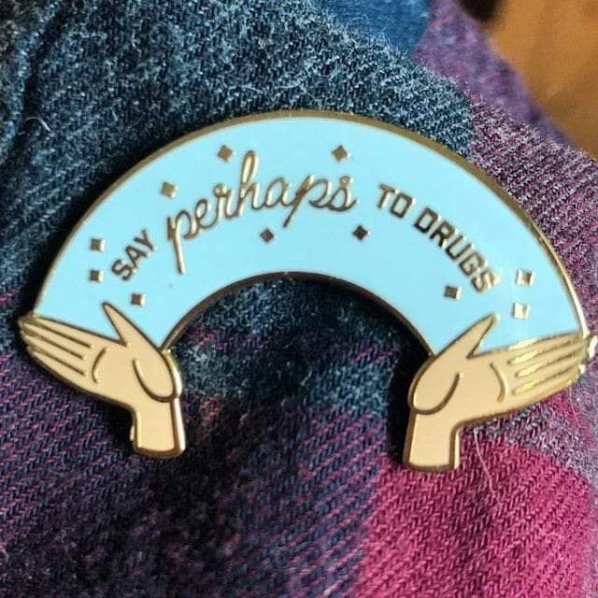
Notes:
Safe supply and decriminalization.

Slide 26
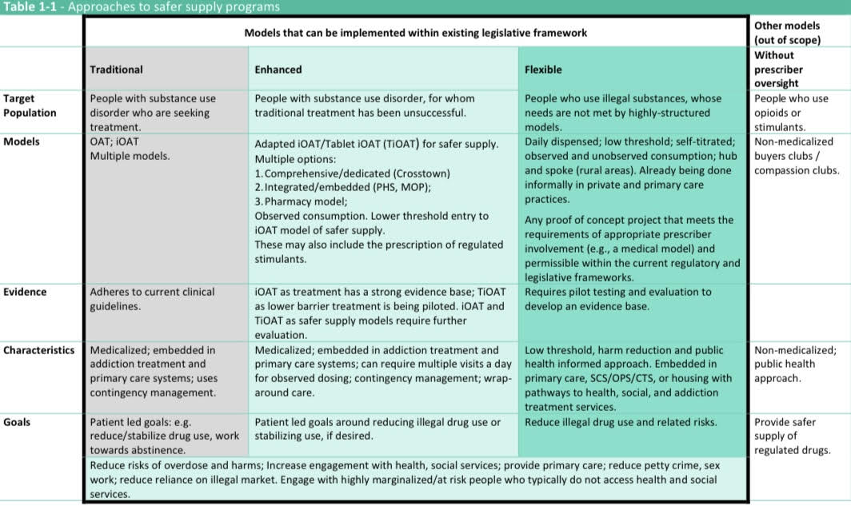
Different Models for Safe Supply
Notes:
Safe supply models as per Health Canada.

Slide 27
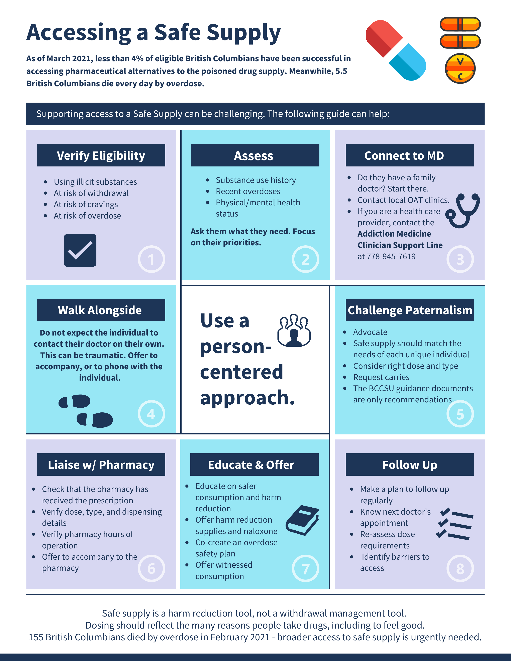
Notes:
Accessing Safe Supply Guiding Tool

Slide 28
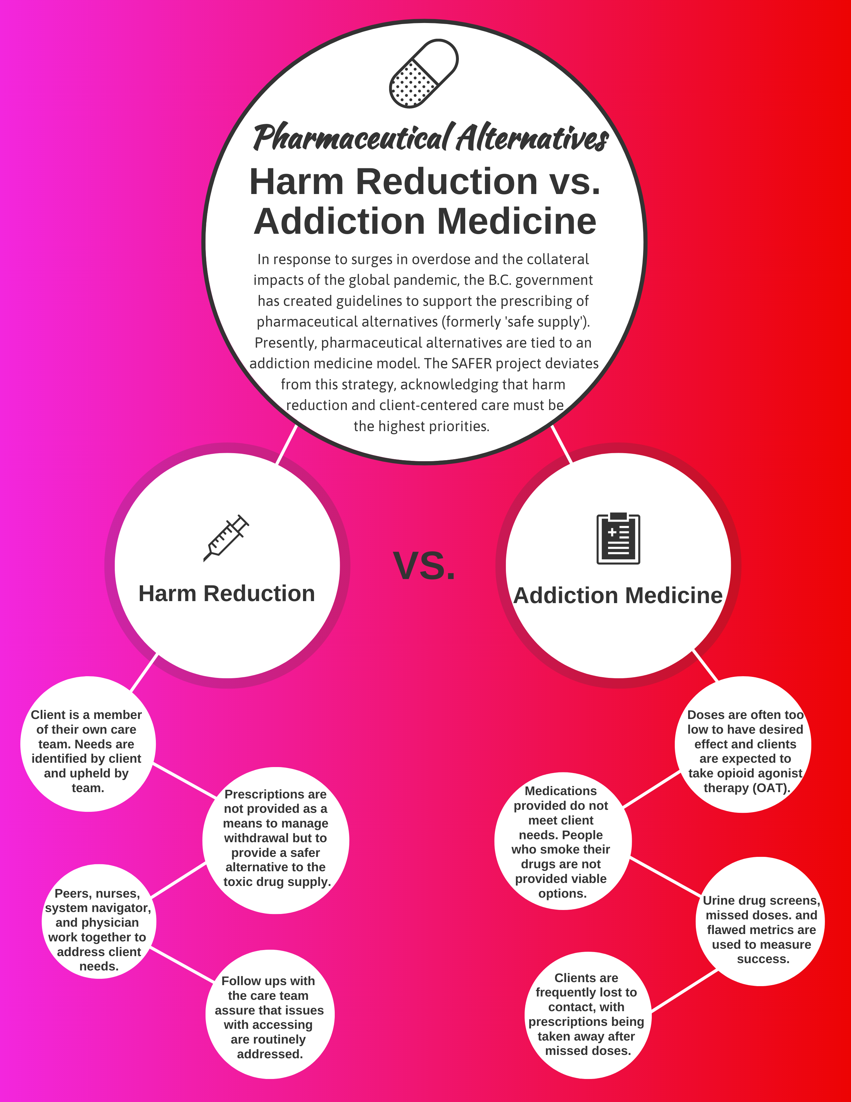
Notes:
The difference between harm reduction and addiction medicine in the provision of pharmaceutical alternatives.

Slide 29
Why Isn’t It Working?
Wrong type of drugs
Wrong dosages
Poor consultation and engagement with PWUD
Delivered through an addictions medicine model (i.e. OAT)
Prescriber gatekeeping (i.e. risk aversion, ideologies, and PPRM)
No consideration for people who smoke their drugs
Too high barrier for access (i.e. urine drug screens, daily dispensing, cut offs)
Rural and remote inequities
Treatment as a condition to safe supply
Notes:
The unfortunate thing, is that Safe Supply has yet to hit the mark when it comes to meeting the needs of people who use drugs.
A great deal of these access issues arise from these mitigation guidelines released by the BC Centre for Substance Use (BCCSU).
The guidelines were never intended to be perfect but to create a starting point so we can continue to innovate and improve as we progress.
The vagueness of the guidelines can make things confusing, and so I am going to walk you through them hopefully in a way that makes you realize, there is a lot we can all do to increase access to safe supply.
Risk aversion, political scapegoating, and it’s only going to get worse.

Slide 30
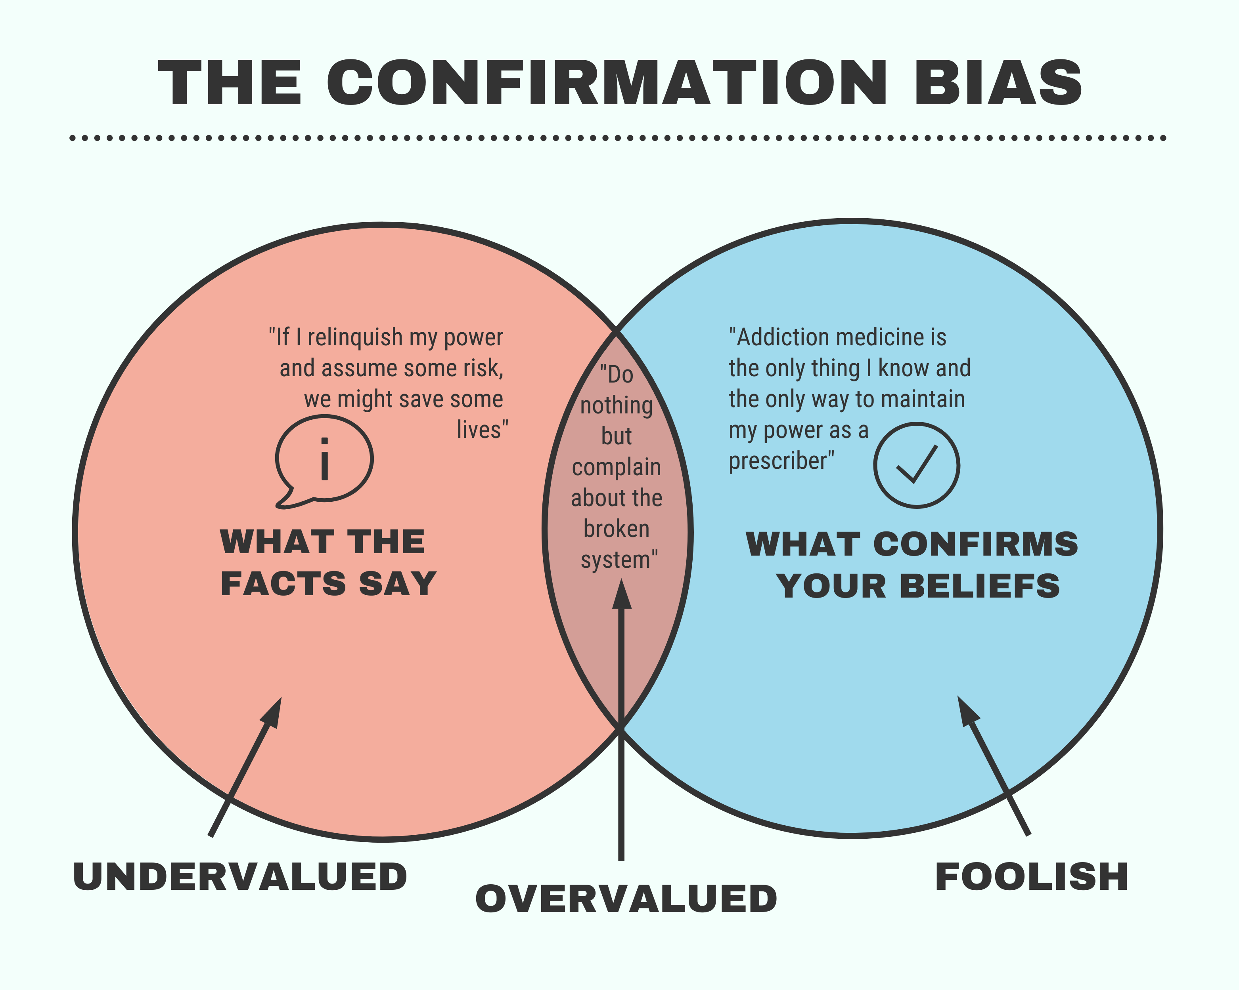
Notes:
As long as safe supply is framed as treatment, it will always be mired in control, and surveillance of PWUD.

Slide 31
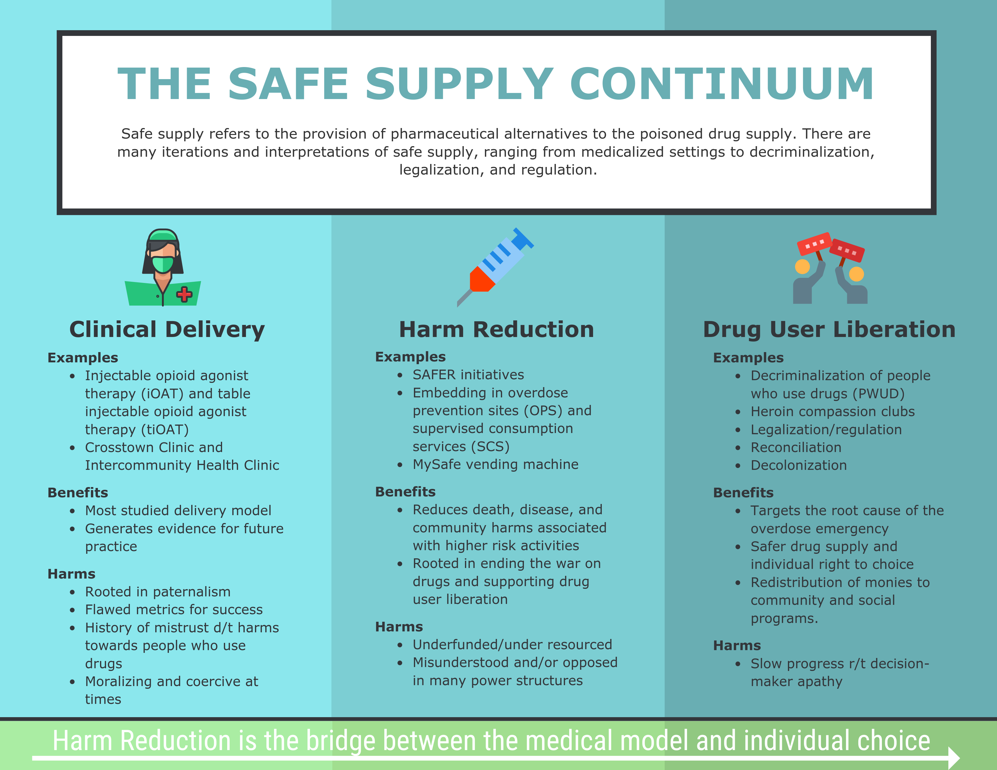
Notes:
The safe supply continuum with examples of how these services operate.

Slide 32
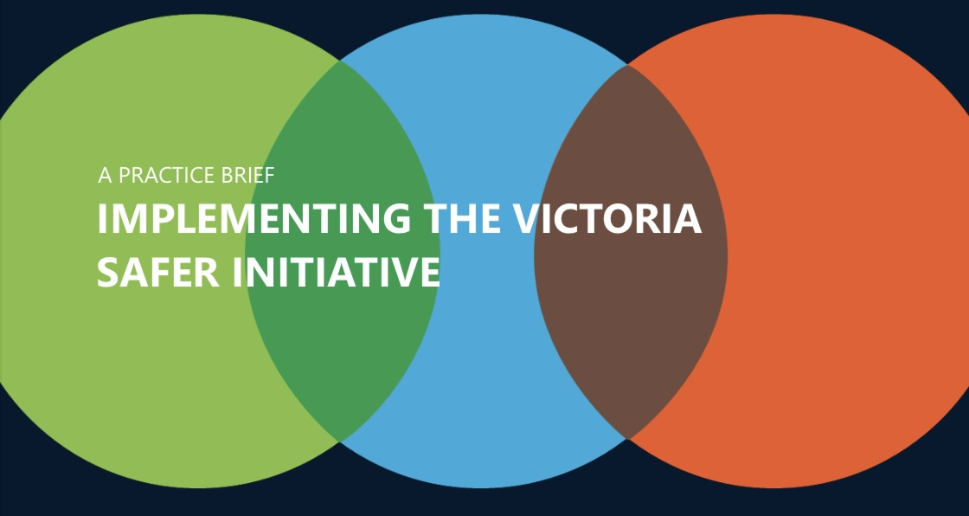
Notes:
SAFER Victoria Initiative
History
Flexible approaches responding to emerging trends

Slide 33
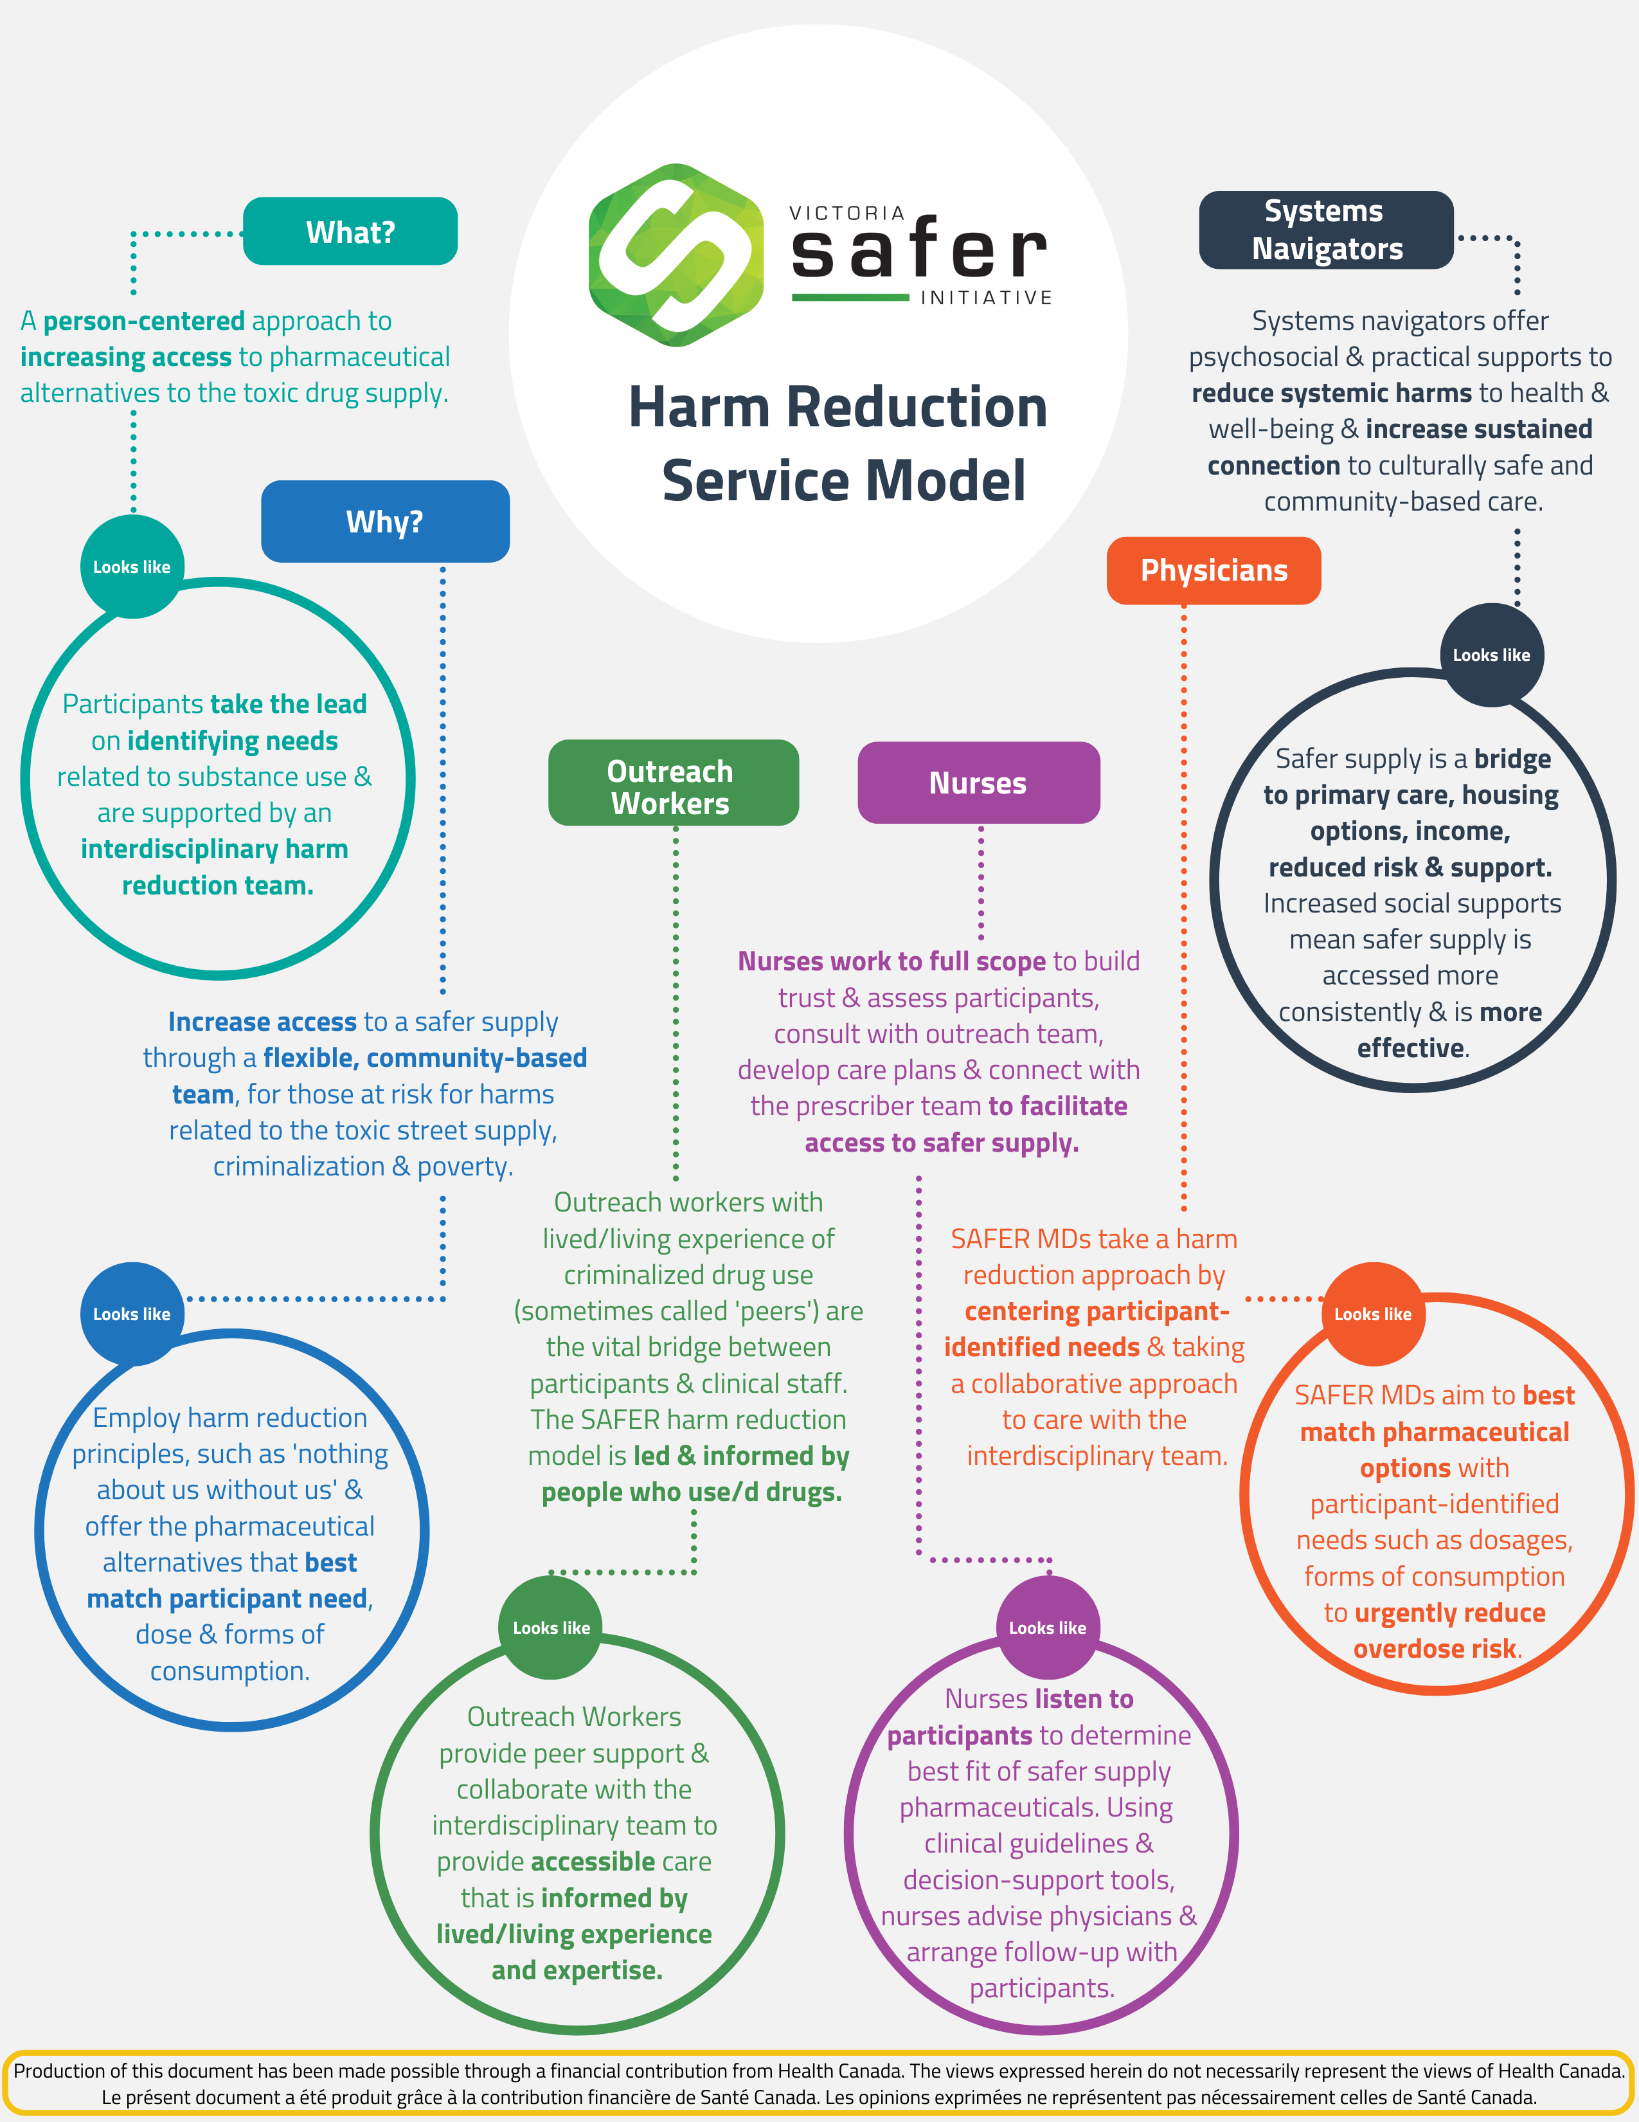
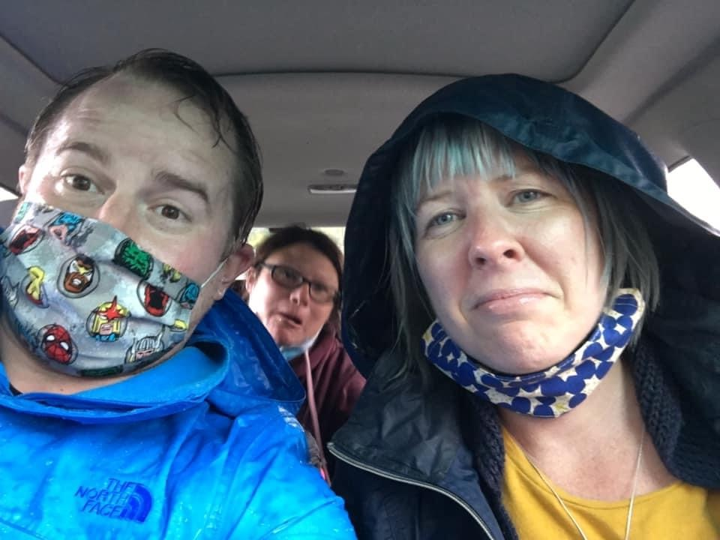

Slide 34
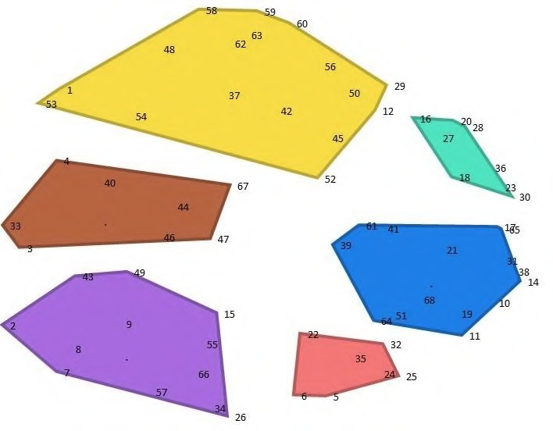
Partnership with SOLID Outreach and Canadian Institute for Substance Use Research
Engages SAFER principle of centering people who use drugs
Concept Mapping methodology
7 initial focus groups with 35 community members; rounds 2 & 3 to analyze, sort & name; over 60 individuals engaged
1. Right Dose and Right Drugs for Me
2. Safe, Positive and Welcoming Spaces
3. Safe Supply and other Services are Accessible to Me
4. I am Treated with Respect
5. I Can Easily Get my Safe Supply
6. Helps Me Function and Improves my Quality of Life (as defined by me)
Notes:
Programs must be informed and led by PWLLE of criminalized drug use.

Slide 35
"Furthermore, as has already been pointed out, even if diversion were to occur if witnessed administration was not required, it would reduce the overall reliance of other drug users on a toxic drug supply.”
“A health care professional would have an ethical obligation to prescribe a medication that would allow the drug user to avoid having recourse to a toxic drug supply rather than the professional insisting on only prescribing on the condition of engaging in individualized medical treatment that extends beyond what the individual specifically requests.”
Notes:
B.C. Government Commissioned an independent Ethics Analysis by Dr. Eike-Henner Kluge.

Slide 36

Updated Stats
98 Active Participants
26 Fentanyl Patch Participants
13 Sufentanil Participants
8 Fentora Participants
7 Inactive Patch Participants
3 Inactive Participants Brought on to Sufentanil
150 Total Connections to Safe Supply
Happy Birthday SAFER!
Clients on fentanyl and sufentanil products early feedback.
Notes:
SAFER Updated Stats*
Up-to-date as of July 2021.

Slide 37
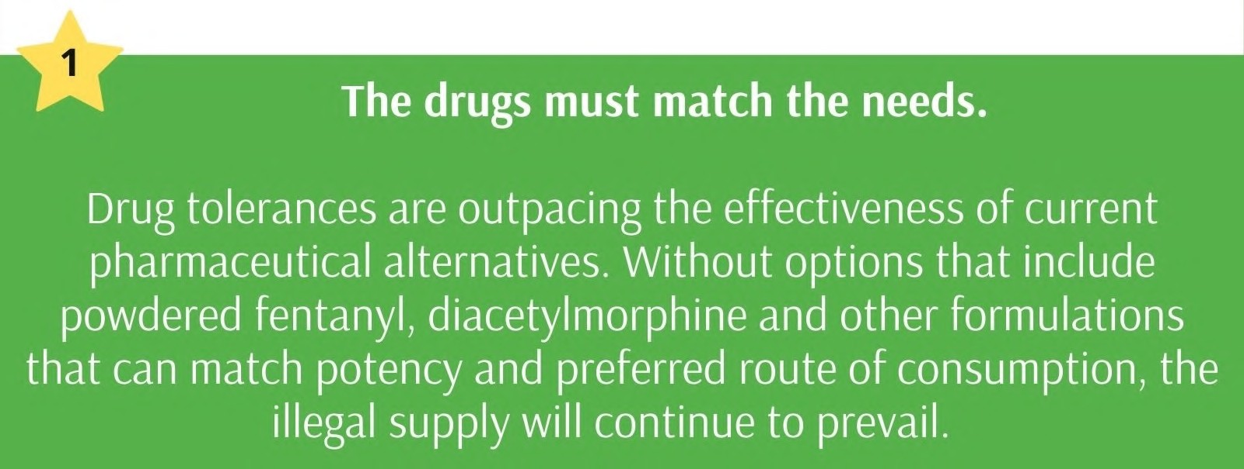
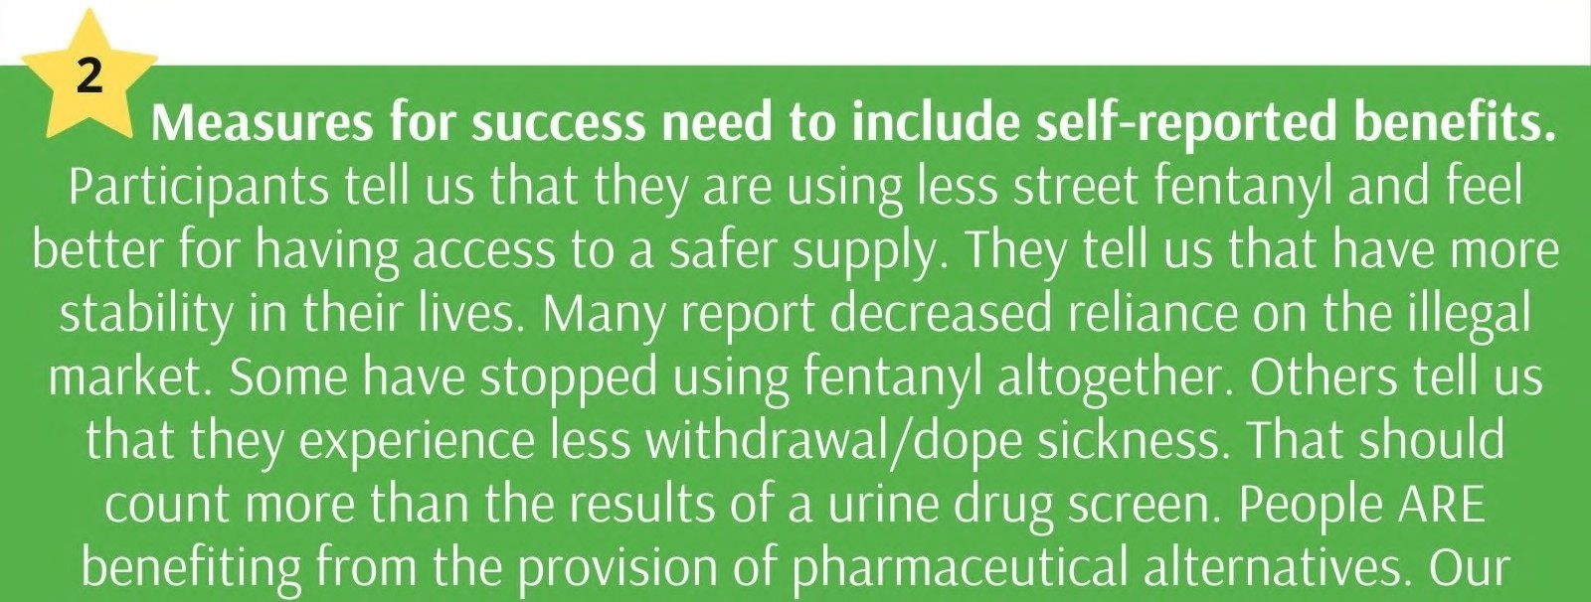
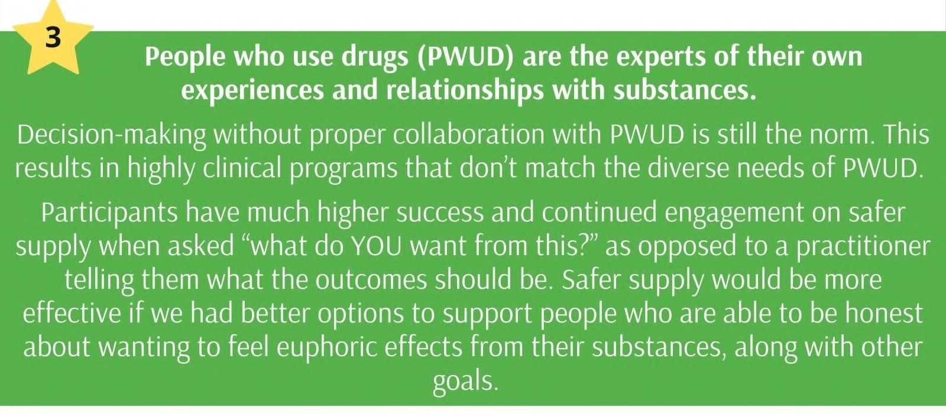
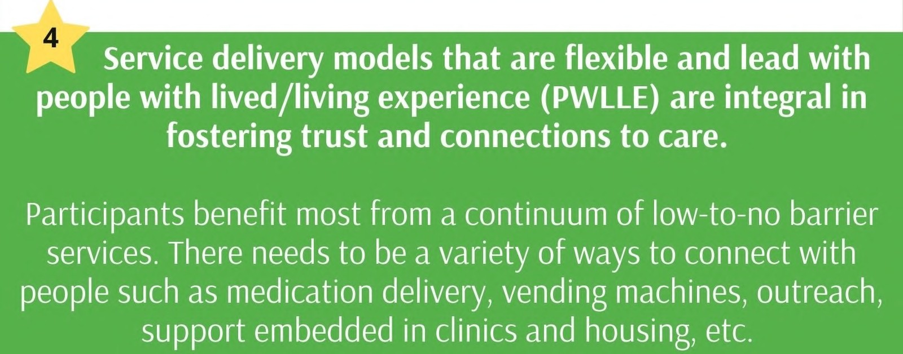
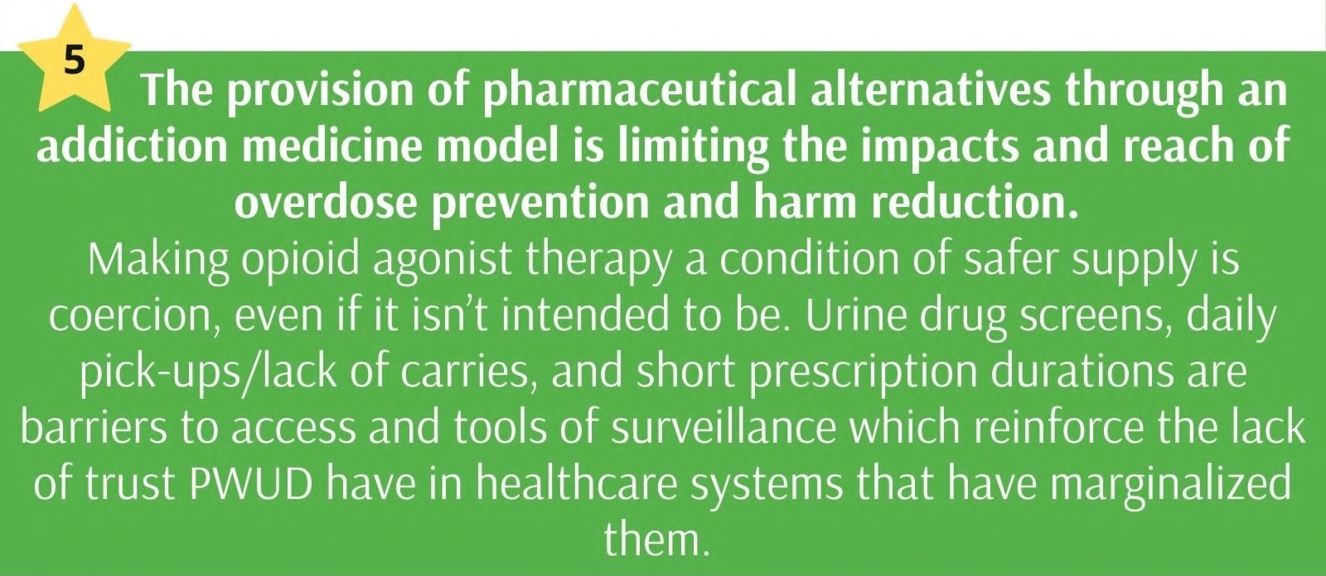
Notes:
SAFER Top 10 part I

Slide 38
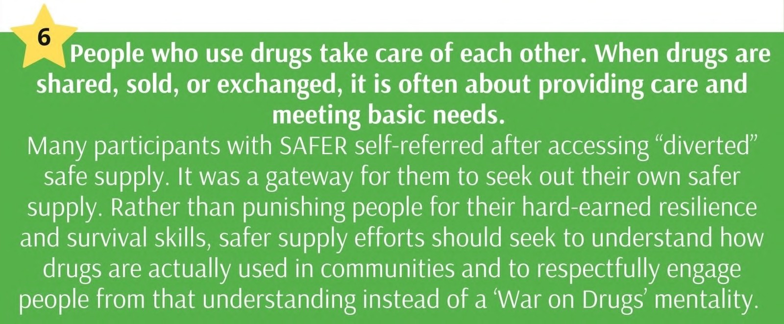
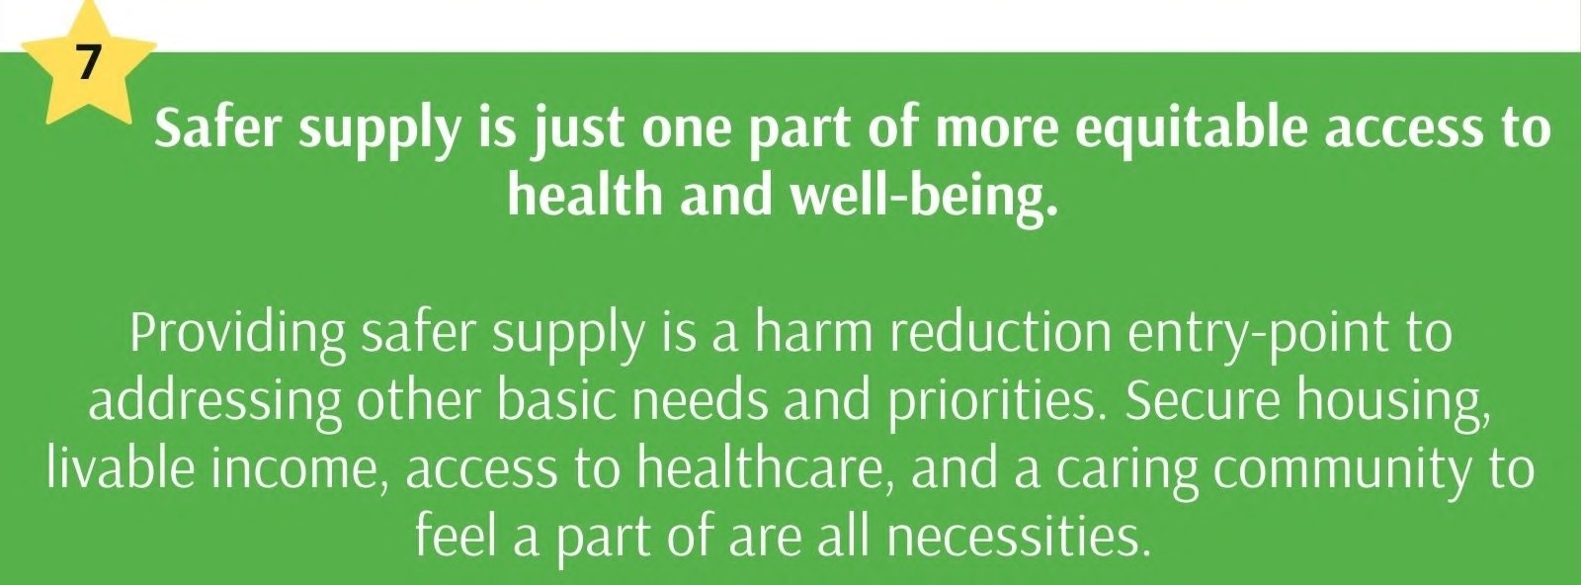
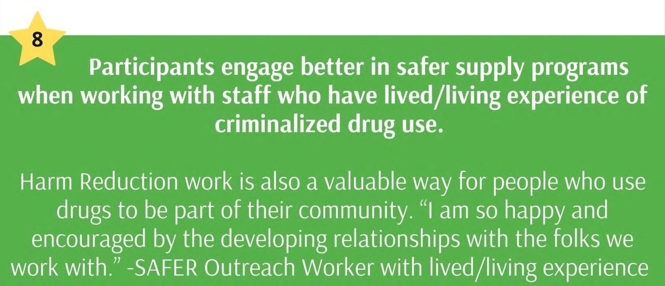
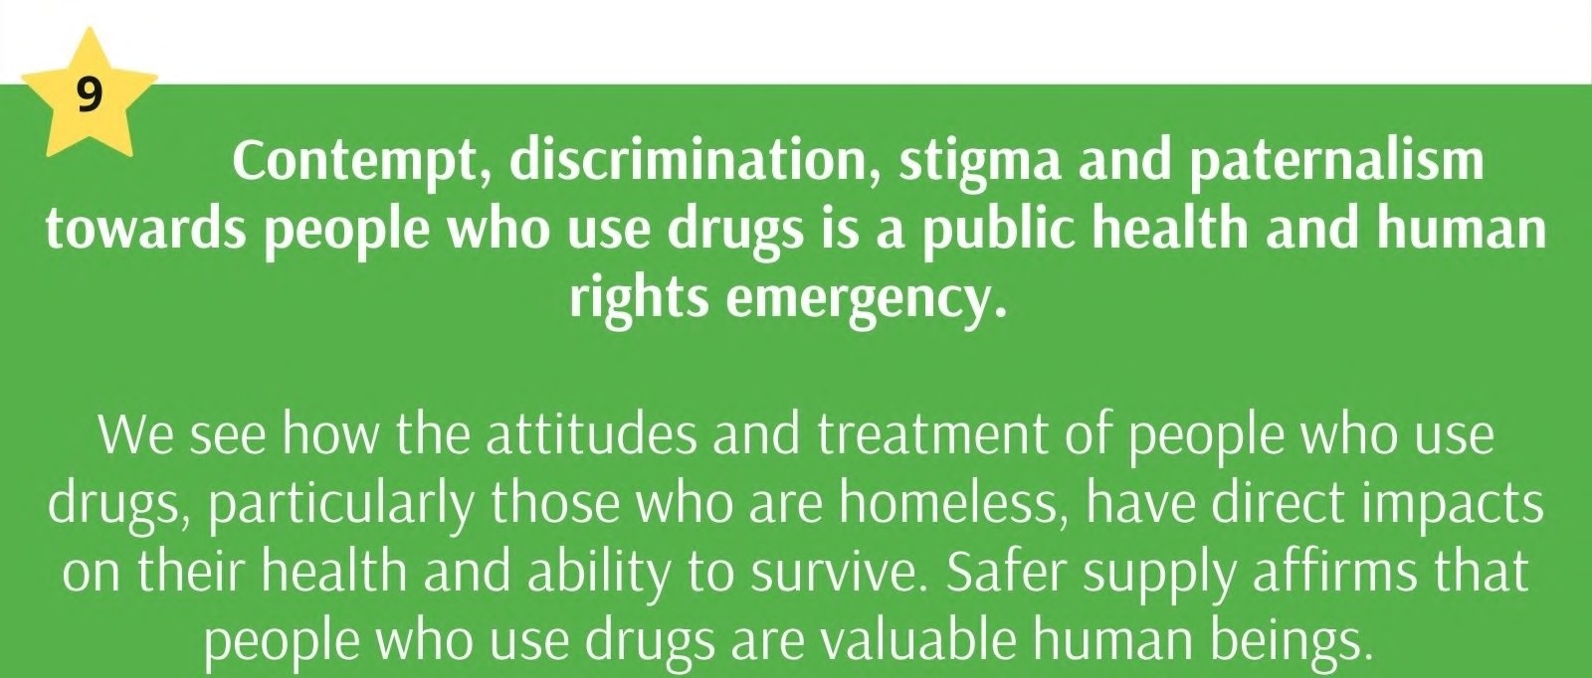
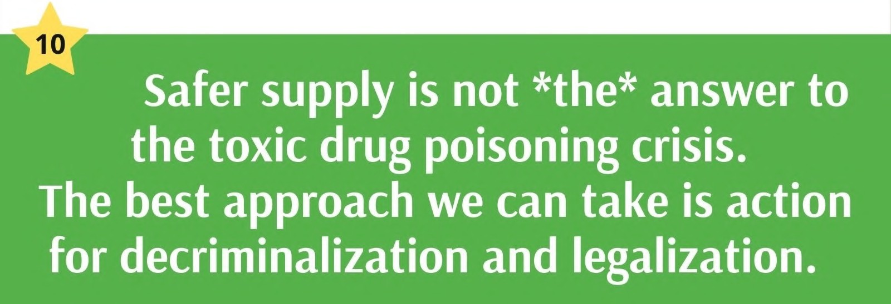
Notes:
SAFER Top 10 part II

Slide 39
Notes:
Art by RN Anna Trowbridge

Slide 40
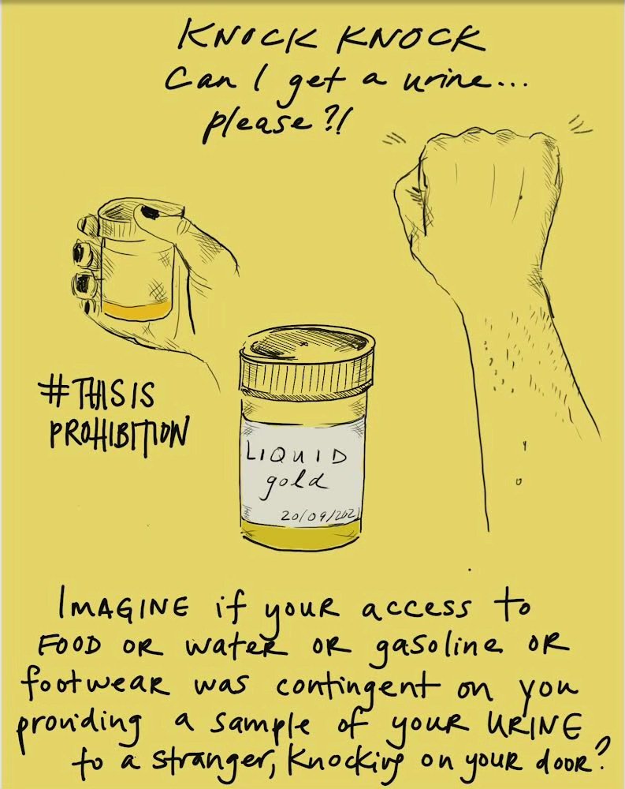
Questions?
Notes:
Art by RN Anna Trowbridge

Slide 41
ADDITIONAL RESOURCES
BCCSU: https://www.bccsu.ca/
CATIE: www.catie.ca
AAWEAR: www.aawear.org
Canadian HIV/AIDS Legal Network: www.aidslaw.ca
Canadian Harm Reduction Network: www.canadianharmreduction.com
First Nations Health Authority: https://www.fnha.ca/WellnessSite/WellnessDocuments/FNHA-Indigenous-Harm-Reduction-Principles-and-Practices-Fact-Sheet.pdf
Government of BC: Policy Enabling Document
Notes:
Speaking of knowledge-Some additional resources to consider!

Slide 42
Select References
Buxton, Preston, Mak, Harvard, Barley and the BC Harm Reduction Strategies and Services Committee. “More Than Just Needles: An Evidence-Informed Approach to Enhancing Harm Reduction Supply Distribution in British Columbia” (2008) https://harmreductionjournal.biomedcentral.com/articles/10.1186/1477-7517-5-37
Wood, Spittal. “Maximizing the Effectiveness of Harm Reduction Programmes” (2003) http://www.ijdp.org/article/S0955-3959(03)00078-1/fulltext
Strike, Challacombe, Myers & Millson. “Needle Exchange Programs: Delivery and Access Issues” (2002) http://www.jstor.org/stable/41993976?seq=1#page_scan_tab_contents
Canadian Centre on Substance Abuse. “Harm Reduction: What’s in a Name?” (2008): pg. 3) http://www.ccsa.ca/Resource%20Library/ccsa0115302008e.pdf
British Columbia Ministry of Health. “Harm Reduction: A British Columbia Community Guide” (2005) http://www.health.gov.bc.ca/library/publications/year/2005/hrcommunityguide.pdf AHS Harm Reduction Policy : https://www.albertahealthservices.ca/info/Page15432.aspx
Alberta Opioid Report Q2 2019: https://open.alberta.ca/dataset/f4b74c38-88cb-41ed-aa6f-32db93c7c391/resource/c23b895d-1922-4d73-86dc-ce170d0a07b3/download/health-alberta-opioid-response-surveillance-report-2019-q2.pdf
http://jmhan.org/index.php/JMHAN/article/view/35 – Role of Nurses in SCS
CNA: https://www.cna-aiic.ca/~/media/cna/page-content/pdf-en/harm-reduction-and-illicit-substance-use-implications-for-nursing.pdf?la=en

